Slide 1
Chemistry in society
Cfe Higher

Slide 2
Getting the most from reactants: designing an industrial process

Slide 3
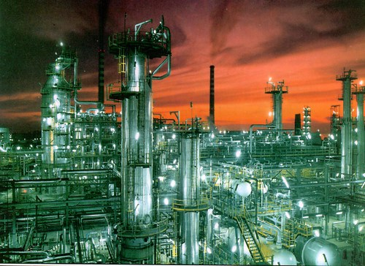
The Chemical Industry

Slide 4
Learning Outcomes
The UK Chemical Industry
The manufacturing process
Aspects of chemical manufacturing
Manufacturing a new product

Slide 5
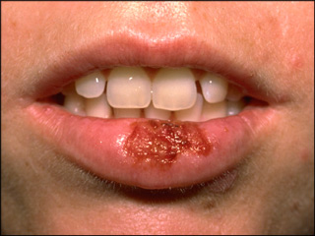
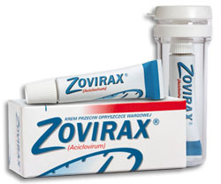
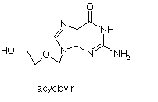

Slide 6
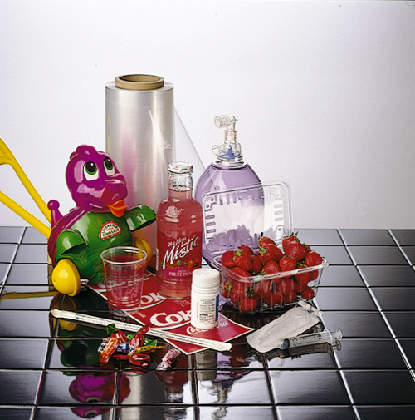
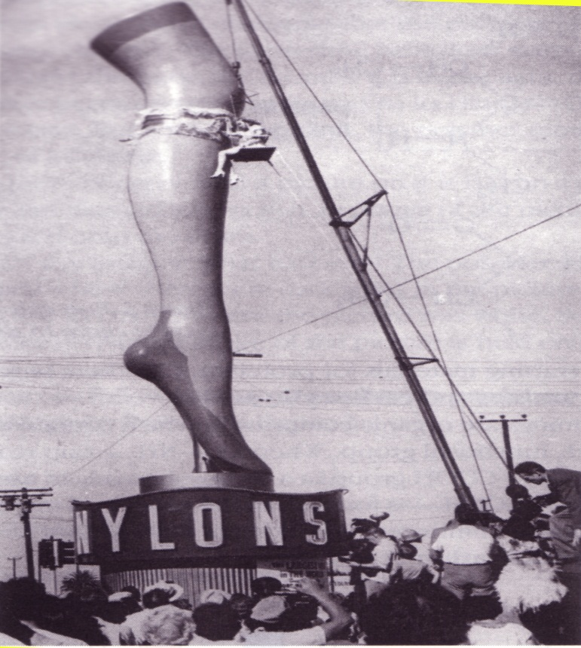
Plastics

Slide 7
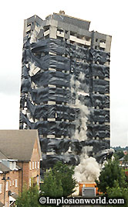
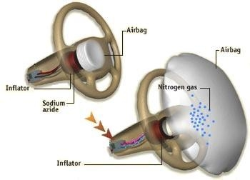
Explosives
Lots of explosives rely on Nitrogen compounds e.g. TNT, nitroglycerine, HMX, and RDX.

Slide 8
The UK Industry
Contributes to the quality of everyday life e.g. plastics, synthetic fibres, detergents, pharmaceuticals, fuels, paints etc.
Plays an important role in the national economy
Provides direct employment for roughly 250 000 people
First established in Scotland and the North of England close to sources of raw materials and in locations with good transport links.

Slide 9
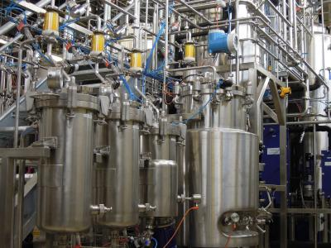
Chemical industry
These chemicals are made on an industrial scale – large amounts!
Needs to be done with minimum waste, and maximum profit

Slide 10
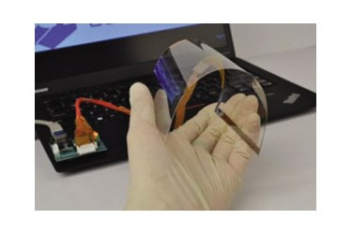
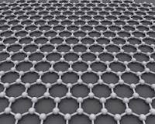
New product creation
Companies can potentially make loads of money from developing a novel product
Either brand new, or ‘better’ products
Several factors involved in developing that…

Slide 11
Considerations
Availability, sustainability and cost of feedstock
Recycling
Energy requirements
Use of by-products
Yield of product

Slide 12
Availability, sustainability and cost of feedstock
Local feedstocks keep cost down
Far afield feedstock will cost more
Safety and environmental concerns
Are stocks going to become scarce? Can become too expensive
E.g. oil and gas prices depending on availability and/or warfare

Slide 13
Recycling
Unreacted chemicals could be fed back in, improves efficiency
Catalysts could be reused
But can be difficult to separate unreacted materials from the product

Slide 14
Energy requirements
Exothermic reactions could be used to sustain the heat in a reaction
Use a catalysts rather than increasing temperatures.

Slide 15
By-products
Find a use for by-products!
If the by-products are toxic or corrosive or damaging, then they can be expensive to get rid of
Eg sulfur dioxide and carbon dioxide can be costly to deal with

Slide 16
Yield of product
Obviously, high yield is good!

Slide 17
Stages in manufacture of a new product
Research and development
Lab process
Pilot plant
Scaling up
Production plant

Slide 18
Manufacturing a new product
Manufacturing a new product starts in research labs where a method of synthesising the product is devised.
A pilot study is then carried out in which larger quantities of the product is made.
The process is then scaled up and the product goes into full production.

Slide 19
The Manufacturing Process
The major raw materials from which all chemicals are derived from are; fossil fuels, air, metal ores, water and minerals.
They provide the feedstocks which go into a chemical process.
(A feedstock is a reactant from which other chemicals can be extracted or synthesised)

Slide 20
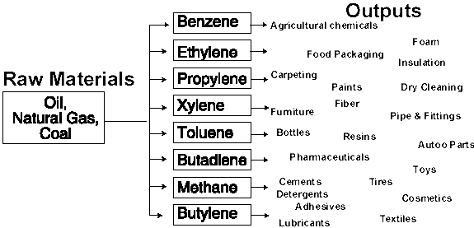

Slide 21
Environmental considerations
Important to protect the environment
1) minimise waste
2) avoid toxic substances
3) design biogradable products
Historically, chemical plants were near the coast, so that waste could go into the sea
Companies now are accountable for their waste

Slide 22
Question
Consider the following list
Air, ethane, ammonia, water, oil, benzene, coal, plastics, fertilizers, sulphuric acid, iron ore, natural gas, aluminium oxide, sodium hydroxide.
Which of the above can be classified as a raw material?

Slide 23
Calculations from Equations

Slide 24
Calculations involving mass

Slide 25
Calculations involving solutions

Slide 26
Calculations involving volumes and concentrations

Slide 27
Calculations involving masses, volumes and concentrations

Slide 28
Calculations involving excess reactant

Slide 29
Excess Calculations

Slide 30
Excess Calculations
Consider a reaction between marble chips and hydrochloric acid.
At the end of the reaction, why are the marble chips left behind?
It must be that they are in excess i.e. all of the acid has reacted and there’s no more left to react with the chips.

Slide 31
Example 1
How much carbon dioxide is evolved if 50g of calcium carbonate is reacted with 100ml of 1moll⁻¹ Hydrochloric acid?

Slide 32
Example 1
How much carbon dioxide is evolved if 50g of calcium carbonate is reacted with 100ml of 1moll⁻¹ Hydrochloric acid?
CaCO₃ + 2HCl → CaCl₂ + CO₂ + H₂O
50g 100ml, 1moll⁻¹

Slide 33
Example 1
How much carbon dioxide is evolved if 50g of calcium carbonate is reacted with 100ml of 1moll⁻¹ Hydrochloric acid?
CaCO₃ + 2HCl → CaCl₂ + CO₂ + H₂O
50g 100ml, 1moll⁻¹
Moles= 0.5 Moles = 0.1

Slide 34
According to the balanced equation, 0.5moles CaCO₃ would react with 1mole of HCl. Clearly, the CaCO₃ is in excess. Therefore, we ignore it and use the moles of HCl to calculate the amount of CO₂ produced.

Slide 35
CaCO₃ + 2HCl → CaCl₂ + CO₂ + H₂O
2 moles → 1 mole
0.1 moles → 0.05 moles
0.05 moles of CO₂ = ?

Slide 36
2. A piece of magnesium weighing 0.6g was added to 40ml of 2mol/l hydrochloric acid.
Mg + 2HCl → MgCl₂ + H₂
Which reactant is in excess?
Calculate the mass of magnesium chloride formed.

Slide 37
3. 2.6g of Zinc was added to 30ml of 1mol/l copper(II) sulphate
Zn + CuSO₄ → ZnSO₄ + Cu
Show by calculation which reactant is in excess.
Calculate the mass of Cu produced.

Slide 38
4. 20ml of 0.2mol/l lead(II)nitrate and 30ml of 1mol/l potassium iodide were mixed.
KI + Pb(NO₃)₂ → PbI₂ + KNO₃
Show by calculation which reactant is in excess.
Calculate the mass of lead iodide produced.

Slide 39
Calculations involving gases (Molar volume)

Slide 40
Molar Volume
In general it is found that, at the same temperature and pressure, all gases have the same molar volume. If, at a certain temperature, one mole of oxygen occupies 24 litre, then under the same conditions of temperature and pressure, all other gases will have the same molar volume of 24 litre.

Slide 42
Example
Calculate the volume of 4 moles of CO₂ at room temperature and pressure.
(Molar volume of CO₂ is 24 L/mole)

Slide 43
Example 1
Calculate the volume of 4 moles of CO₂ at room temperature and pressure.
(Molar volume of CO₂ is 24 L/mole)
1 mol → 24L
4 mol → 4 x 24 = 96L

Slide 44
Example 2
Calculate the volume of 1.0g of He at room temperature and pressure. (Molar volume = 24L/mole ).

Slide 45
Example 2
Calculate the volume of 1.0g of He at room temperature and pressure. (Molar volume = 24L/mole).
n = m/FM
= ¼ = 0.25
1 Mol = 24 L
0.25 Mol = 24 x 0.25 = 6L

Slide 46
Example 3
Calculate (a) the number of moles in 6.0 litres of oxygen
(b) the mass of 0.60 litres of oxygen
(molar volume is 24litres/mole )

Slide 47
Reacting volumes

Slide 48
Reacting Volumes
Balanced equations can be used in order to calculate the volumes of reactants or products.

Slide 49
Example 1
2SO₂(g) + O₂ (g) → 2SO₃(g)
2 mol 1 mol 2 mol
2 litre 1 litre 2 litre
10cm³ 5cm³ 10cm³
2 volume 1 volume 2 volume

Slide 50
NB – Any reactants or products that are solid or liquid are assumed to have zero volume.
E.g
2H₂(g) + O₂(g) → 2H₂O(l)
2 mol 1 mol 2 mol
2L 1L 0L
10ml 5ml 0ml

Slide 51
Calculate the volume of oxygen required for the complete combustion of 100cm³ methane.
CH₄(g) + 2O₂(g) → CO₂ (g) + 2H₂O (l)

Slide 52
Calculate the volume of oxygen required for the complete combustion of 500cm³ methane.
CH₄(g) + 2O₂(g) → CO₂ (g) + 2H₂O (l)

Slide 53
Calculate the volume of the gas mixture which remains in the reaction vessel when 500cm³ of methane reacts with 100cm³ of oxygen.
CH₄(g) + 2O₂(g) → CO₂ (g) + 2H₂O (l)

Slide 54
Calculate the volume of the gas mixture which remains in the reaction vessel when 700cm³ of methane reacts with 200cm³ of oxygen.
CH₄(g) + 2O₂(g) → CO₂ (g) + 2H₂O (l)

Slide 55
Percentage yield and atom economy

Slide 56
Percentage Yield

Slide 57
Learning Outcome
Percentage yields can be calculated from mass of reactant(s) and product(s) using balanced equations.

Slide 58
Types of yield
The yield of a chemical reaction is the amount of product obtained. There are two types:
Theoretical yield – The maximum amount of product that could be produced if there was 100% conversion.
Actual yield – The amount that is actually obtained.

Slide 59
Actual smaller than theoretical – Why?
Reaction could be reversible
Side reactions may occur
Some of the product may be lost
Reactants may not be 100% pure

Slide 60
Example 1
C₂H₂ + 2HCl C₂H₄Cl₂
What mass of product can theoretically be obtained if 0.1 moles of HCl is reacted with excess ethyne?
What is the % yield if only 4.1g of product are obtained
% yield= actual yield/ theoretical yield x100

Slide 61
Example 2
C₂H₂ + 2HCl C₂H₄Cl₂
What mass of product can theoretically be obtained if 0.5 moles of HCl is reacted with excess ethyne?
What is the % yield if only 20 g of product are obtained
% yield= actual yield/ theoretical yield x100

Slide 62
Example 3
Ammonia is made in the Haber process:
N₂(g) + 3H₂(g) → 2NH₃(g)
What mass of product can theoretically be obtained if 0.15 moles of H₂ is reacted with excess Nitrogen?
What is the % yield if only 1g of product is obtained
% yield= actual yield/ theoretical yield x100

Slide 63
Example 4
A sample of methyl ethanoate (6.9g) was obtained when 9g ethanoic acid was added to excess methanol. Calculate the % yield of the ester.
Write a balanced chemical equation.
% yield= actual yield/ theoretical yield x100

Slide 64
Atom Economy

Slide 65
% yield gives us information about how successful the reaction is at converting reactants into products
Doesn’t give us information on by products
Atom economy allows us to examine the proportion of reactant converted into desired product.

Slide 66
Atom economy = mass of desired product(s)
x100
total mass of reactants

Slide 67
Atom economy

Slide 68
Equilibria

Slide 69
Learning Outcomes
Shifting the equilibrium position
Effect of changing concentration of reactants/products, pressure and temperature on the position of the equilibrium.

Slide 70
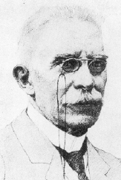
Henri Le Chatelier (1850-1936)

Slide 71
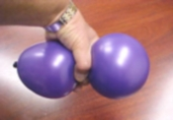
Stress Relief
• Imagine you squeeze a balloon on one side.
• Air moves toward the other side of the balloon causing the it to bulge.
• As a result, the pressure is reduced on the side where you are squeezing.
• The air moves in a way that relieves the stress caused by the increased pressure.

Slide 72
Le Chatelier’s principle = when stress is applied to a system in equilibrium, the reaction will shift in a direction that relieves the stress, and a new equilibrium will be established.
(At equilibrium, the concentrations of reactants and products remain constant, although not necessarily equal.)

Slide 73
Changing the Equilibrium
Applied stresses
changes in concentration,
changes in temperature
changes in pressure

Slide 74
Increasing concentration of a reactant.
If the concentration of a reactant is increased, the reaction will shift in a way that reduces it’s concentration.
Shift
A + B C + D
+
A

Slide 75
Decreasing concentration of a product
If the concentration of a product is decreased, the reaction will shift in a way that increases it’s concentration.
Shift
A + B C + D

Slide 76
Increasing temperature
If the temperature increases, the reaction will shift in a way that uses heat.
Exothermic
Endothermic
A + B C + D
Shift

Slide 77
Decreasing temperature
If the temperature decreases, the reaction will shift in a way that releases heat.
Shift
Exothermic
Endothermic
A + B C + D

Slide 78
Increasing pressure (gas only)
If the pressure increases, the reaction will shift in a way that reduces pressure by decreasing the number of particles (less moles of gas)
N2O4(g) 2NO2(g)
1 mole 2 moles
Shift

Slide 79
Decreasing pressure (gas only!!)
If the pressure decreases, the reaction will shift in a way that increases pressure by increasing the number of particles (more moles of gas)
Shift
N2O4(g) 2NO2(g)
1 mole 2 moles

Slide 80
Le Châtelier’s Principle
What effect does adding a catalyst have on the equilibrium?
Adding a Catalyst
does not shift the position of an equilibrium system
system will reach equilibrium sooner

Slide 81
Le Châtelier’s Principle
System starts at equilibrium.
A change/stress is then made to system at equilibrium.
Change in concentration
Change in pressure
Change in Temperature
3. System responds by shifting to reactant or product side to restore equilibrium.

Slide 82
Equilibrium and the Haber Process
N2(g) + 3H2(g) 2NH3(g) ΔH = -92kJ
How can we use Le Châtelier’s principle to produce more ammonia?
Decrease the concentration of ammonia
Increase the concentration of N2 or H2
Decreasing temperature
Increasing pressure

Slide 83
Chemical Energy

Slide 84
Experimental Measurement of Enthalpy Changes
Enthalpy of Combustion “the enthalpy change when 1mole of a substance is burned completely in oxygen.”

Slide 85
calculate the heat released when 4g of methane is burned
16g → -891 kJ
1g → -891/16 = -55.69kJ
4g → 4x -55.69 = -222.75 kJ

Slide 86
Examples
Using the data book values for the enthalpy of combustion, calculate the heat released when the following are burned
(a) 640g of Sulphur (b) 10g of propane (C₃H₈)
Will it be a +’ve or a –’ve sign?!?!?!?!

Slide 87
Examples
Write equations showing the combustion of each of the following and write the appropriate ΔH value from the data booklet.
Methane Propane Ethanol, C₂H₅OH
Propanol, C₃H₇OH

Slide 88
Examples
You can also use given values of heat released to calculate the enthalpy of combustion of a substance.
E.g. 4g of ethene released 200kJ of energy. Calculate the enthalpy of combustion of ethene.
4g → -200 kJ
1g → -200/4 = -50kJ
28g → -50 x 28 = -1400kJ mol-1

Slide 89
Examples
Calculate the enthalpy of combustion for the following compounds.
(a) 3g of methane released 160kJ (b) 4g of carbon released 130kJ.

Slide 90
When performing experiments, water is used to “capture” the heat released by substances reacting as it is known how much energy is needed to cause the temperature of water to rise.
This is known as the specific heat capacity of water (symbol c) and has a value of 4·18 kJ kg^{–1} °C^{–1} (see page 19 of the data booklet)

Slide 91
“to raise the temperature of 1 kg of water by 1ºC requires 4.18kJ” = Specific heat capacity of water = c
We can use the equation: E= c m_{w} ΔT
C = 4·18 kJ kg^{–1} °C^{–1}
m_{w} = mass of water heated (since the answer is in kJ, this must be in kg. Use the conversion that 1 litre of water= 1kg)
ΔT = the temperature change

Slide 92
Examples
Calculate the energy needed to heat
(a) 2 kg water by 5ºC
(b) 100 g water by 25ºC
“to raise the temperature of 1 kg of water by 1ºC requires 4.18kJ”

Slide 93
Examples
When 20g of calcium was heated, it raised the temperature of 200cm³ of water by 14ºC. Calculate the enthalpy of combustion of calcium.
When 5g of methanol (CH₃OH) was burned, it raised the temperature of 50cm³ of water from 20ºC to 25ºC. Calculate the enthalpy of combustion of the methanol.

Slide 96
Problems with this technique
1. Heat loss
2. Incomplete combustion

Slide 97
Example
Calculate the enthalpy of combustion of ethanol using the following results.
Mass of spirit burner at the start= 20g
Mass of spirit burner at the end= 19.3g
Volume of water heated= 50cm³
Temperature of water at the start = 20ºC
Temperature of water at the end= 35ºC

Slide 99
Enthalpy of Solution
“the enthalpy change when one mole of a substance is completely dissolved in water.”

Slide 100
Examples
When 20g of NH₄NO₃ was dissolved in 100cm³ of water the temperature fell from 22ºC to 18ºC. Calculate the enthalpy of solution.
Calculate the enthalpy of solution of sodium chloride given that 10g took in 25kJ of energy.
Calculate the enthalpy of solution of NaOH from the following data:
Mass of NaOH = 1.2g Volume of water used = 50cm³
Initial temp of water = 20.2 ºC Temp of solution = 26.4 ºC

Slide 101
Enthalpy of Neutralisation
“The enthalpy change when 1 mole of water is formed in a neutralization reaction.”

Slide 102
Learning Otucomes
Be able to state Hess’s law
Be able to calculate enthalpy changes by application of Hess’s law.

Slide 103
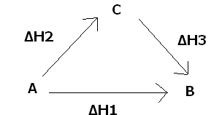
Hess’s Law
What is Hess’s Law?
Hess’s law states that the enthalpy change for a chemical reaction is independent of the route taken.
B can be directly made from A or via C.
Hess’s law states that ΔH₁ = ΔH₂ + ΔH₃

Slide 104
Manipulating chemical equations
Hess’s Law calculations are usually done by writing out the balanced chemical equation for the enthalpy change you are trying to calculate.
Other chemical equations are then manipulated to give the desired equation. They can be reversed or multiplied. Whatever operation is carried out on the equation has to be carried out on the value of the enthalpy change (ΔH).

Slide 105
Example
Calculate the enthalpy of formation of ethane from carbon and hydrogen:
2C(s) + 3H₂(g) → C₂H₆(g) ΔH=?
In practice carbon and hydrogen do not react to form ethane and so ΔH cannot be determined experimentally.
A calculation based on Hess’s law can be used to determine ΔH.

Slide 106
*PAGE 9 – DATA BOOK*
The enthalpies of combustion of carbon, hydrogen and ethane have been determined experimentally and are in the data book. These can be used to calculate ΔH.

Slide 107
Step 1
Write the balanced chemical equations for the combustion of carbon, hydrogen and ethane. Note the ΔH values(pg 9 data book).

Slide 109
C + O₂ → CO₂ ΔH = -394kJ/mol
H₂ + ½ O₂ → H₂O ΔH = -286kJ/mol
C₂H₆ + 3½O₂ → 2CO₂ + 3H₂O ΔH= -1560kJ/mol

Slide 110
Step 2
Write a balanced equation representing the desired enthalpy change.
2C(s) + 3H₂(g) → C₂H₆(g) ΔH=?
This is the target equation – we will use Hess’s law to get to this equation from the three equations in step 1.

Slide 111
Step 3
Involves equations 1, 2 and 3 in step 1.
C + O₂ → CO₂ ΔH = -394kJ/mol
H₂ + ½ O₂ → H₂O ΔH = -286kJ/mol
C₂H₆ + 3½O₂ → 2CO₂ + 3H₂O ΔH= -1560kJ/mol
In the target equation there are two carbons on the left side and in equation 1 there is one carbon.
Equation 1 needs to be multiplied by 2 (the enthalpy value too!)

Slide 112
Step 3
Equation 2 needs to be multiplied by 3 since there are 3 H₂’s in the target equation (enthalpy value too!).

Slide 113
Step 3
The target equation has C₂H₆ on the right hand side, whereas equation 3 has it on the left.
Equation 3 needs to be reversed. This means that the enthalpy value’s sign will change.

Slide 114
Add up these changes
2C + 2O₂ → 2CO₂ ΔH= -788kJ
3H₂ +1½ O₂ →3H₂O ΔH= -858kJ
2CO₂ + 3H₂O → C₂H₆ + 3½O₂ ΔH=+1560kJ
There are some things that appear on both sides of the equations. We can cancel them out.

Slide 115
This leaves us with
2C(s) + 3H₂(g) → C₂H₆(g)
The Target equation!!
Since adding these three equations gives us the target equation, then the enthalpy change values will give us ΔH.
ΔH= -788 – 858 +1560 = -86kJ/mol

Slide 116
Examples
Example 1: Use Hess’s law and the enthalpies of combustion from the data booklet to calculate the enthalpy change for the following reaction:
C (s) + 2H₂ (g) → CH₄ (g) ΔH=?

Slide 117
Example
Calculate the enthalpy of formation of ethanol.
2C + 3H₂ + ½ O₂ → C₂H₅OH
Do not be confused by the oxygen, you cannot write a combustion reaction for it! Follow the steps as previously described.

Slide 118
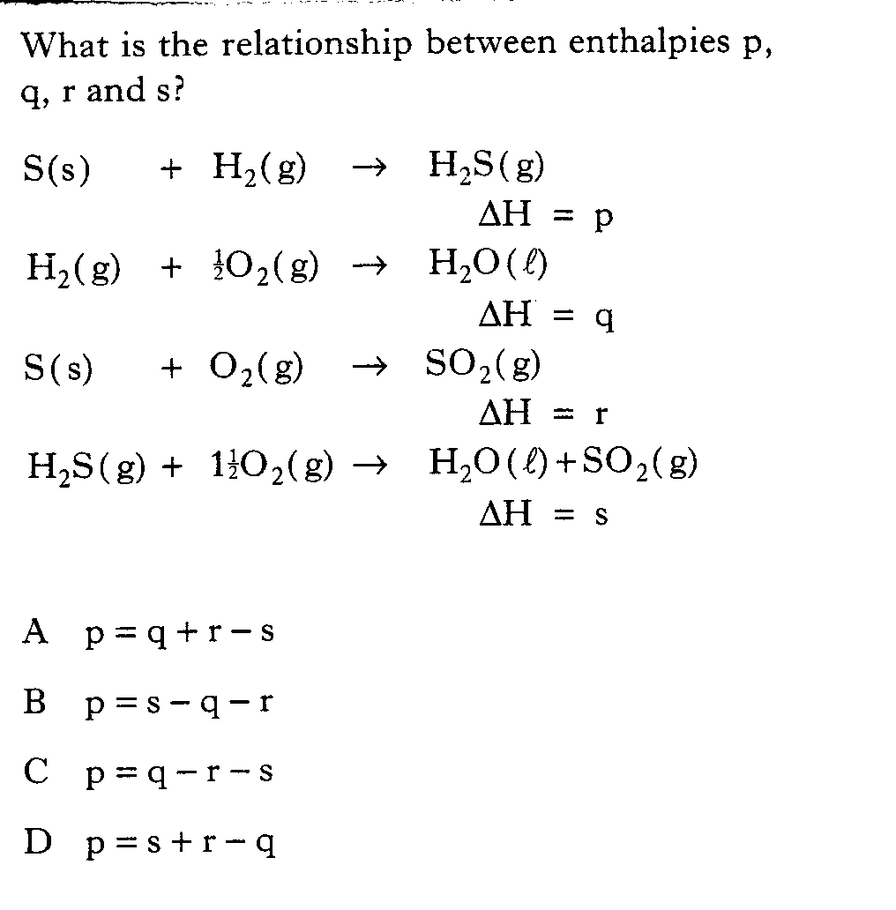

Slide 119
Calculation of the enthalpy change using bond enthalpies
Bond breaking is endothermic (∆H is positive)
Bond making is exothermic (∆H is negative)

Slide 120
Calculation of the enthalpy change using bond enthalpies

Slide 121
Oxidising and reducing agents

Slide 122
Learning Outcomes
Oxidising and reducing agents can be identified in redox reactions.
Understand the relationship between electronegativity and the ability of a substance to act as an oxidising agent or reducing agent
Be able to write Ion-electron equations for oxidation and reduction reactions.
Be able to write redox equations by combining Ion-electron equations.
Be able to state what an oxidising and reducing agent is.

Slide 123
Redox Reactions
Revision – State the meaning of the following:
Oxidation –
Reduction –
Redox -

Slide 124
OIL RIG
Oxidation
Is
Loss
Reduction
Is
Gain

Slide 125
Ion – Electron equations
Use the data book to help you write ion electron equations for the following. Label each equation as O or R where appropriate.
Chlorine gas forming chloride ions
Magnesium forming magnesium ions
Copper (II) ions forming copper atoms
Bromide ions forming bromine molecules
Oxidation of aluminium

Slide 126
Label the following as oxidation or reduction reactions
(a) Zn²⁺(aq) + 2e⁻ → Zn(s)
(b) Cobalt (II) → Cobalt (III)
(c) I₂ → 2I⁻
(d) copper atoms → copper ions

Slide 127
Redox reactions happen when oxidation and reduction reactions occur. A redox equation can be formed when the oxidation and reduction reactions are combined.

Slide 128
Example
Consider the reaction between Iron(II) sulphate solution and acidified potassium dichromate solution. Iron (III) ions and chromium (III) ions are formed.
Write down the equation for the oxidation reaction.

Slide 129
Fe²⁺(aq) → Fe³⁺(aq) + e⁻
The fact that the iron(II) ions have been oxidised implies that the dichromate ions must have been reduced to chromium(III) ions.
Cr₂O₇²⁻(aq) → Cr³⁺(aq)
This equation needs to be balanced!

Slide 130
Balance the non oxygen element, in this case chromium. Cr₂O₇²⁻(aq) → 2Cr³⁺(aq)
Balance the oxygen. The oxygen is introduced as water molecules.
Cr₂O₇²⁻(aq) → 2Cr³⁺(aq) + 7H₂O(l)
Balance the hydrogen by introducing hydrogen ions. Cr₂O₇²⁻(aq) + 14H⁺(aq) → 2Cr³⁺(aq) + 7H₂O(l)
Finally, balance the charges by introducing electrons. 6 e- + Cr₂O₇²⁻(aq) + 14H⁺(aq) → 2Cr³⁺(aq) + 7H₂O(l)
What side do the electrons appear on? Does this tell us its an oxidation or reduction process?

Slide 131
NB
The ion electron equations in your data book are all written as reductions, so to write an oxidation ion-electron equation you need to reverse it.
There will be occasions where you are asked to write an ion-electron equation which doesn’t appear in the data book. In these cases you must derive it from the rules previously described.

Slide 132
Redox equations
Write down the ion electron equations for
1) SO₃²⁻ → SO₄²⁻
2) MnO₄⁻ → Mn²⁺

Slide 133
During a redox process in acid solution, iodate ions, IO₃⁻(aq), are converted into iodine, I₂(aq).
IO₃⁻(aq) → I₂(aq)
The number of H⁺(aq) and H₂O(l) required to balance the ion-electron equation for the formation of I₂(aq) are , respectively:
A - 6 and 3
B - 3 and 6
C - 12 and 6
D - 6 and 12

Slide 134
SO₃²⁻ + H₂O → SO₄²⁻ + 2H⁺ + 2e⁻
MnO₄⁻ + 8H⁺ + 5e⁻ → Mn²⁺ + 4H₂O
Balanced equations for redox reactions can be written by combining ion electron equations for oxidation and reduction processes.
The number of electrons lost in the oxidation process must equal the number gained in the reduction process.

Slide 135
The oxidation process needs to be multiplied by 5 and reduction process by two.
5SO₃²⁻ + 5H₂O → 5SO₄²⁻ + 10H⁺ + 10e⁻
2MnO₄⁻ + 16H⁺ + 10e⁻ → 2Mn²⁺ + 8H₂O
Add these equations together.

Slide 136
5SO₃²⁻ + 5H₂O + 2MnO₄⁻ + 16H⁺ + 10e⁻
5SO₄²⁻ + 10H⁺ + 10e⁻ + 2Mn²⁺ + 8H₂O
Can anything be cancelled out?

Slide 137
5SO₃²⁻ + 2MnO₄⁻ + 6H⁺ 5SO₄²⁻ + 2Mn²⁺ + 3H₂O
The H⁺ ions, H₂O molecules and electrons can all be cancelled out. Electrons, spectator ions and spectator molecules must not feature in redox equations.

Slide 138
The iron (II) ions in a sample of iron(II) sulphate were oxidised using acidified permanganate solution. Write the balanced redox equation for the reaction.
Fe²⁺ → Fe³⁺ + e⁻
MnO₄⁻ + 8H⁺ + 5e⁻ → Mn²⁺ + 4H₂O

Slide 139
To balance the electrons gained and lost x5
5Fe²⁺ → 5Fe³⁺ + 5e⁻
MnO⁴⁻ + 8H⁺ + 5e⁻ → Mn²⁺ + 4H₂O
MnO⁴⁻ + 8H⁺ + 5Fe²⁺ → Mn²⁺ + 5Fe³⁺ + 4H₂O

Slide 140
Oxidising and Reducing agents
When a substance is oxidised it loses/donates electrons. For this to happen, another substance needs to gain/accept these electrons and be reduced.
The electron acceptor is known as the oxidising agent, and the electron donor is known as the reducing agent.

Slide 141
Where do we find oxidising agents?
In the electrochemical series, the most powerful oxidising agents are shown at the bottom.
Fluorine is the most powerful oxidising agent (it wants to accept e⁻)
F 2,8,7 Electronegativity=4.0
It wants an electron.
It wants to be reduced

Slide 142
Where do we find reducing agents?
The most powerful reducing agents are at the top. Lithium is the most powerful.
Li 2,1 Electronegativity=
It wants to lose an electron
It wants to be oxidised.
Li(s) → Li⁺(aq) + e⁻

Slide 143
Balancing Redox reactions
The copper (I) ions in a sample of copper(I) sulphate were oxidised using potassium dichromate solution. Write the balanced redox equation for the reaction.

Slide 144
Chromatography

Slide 145
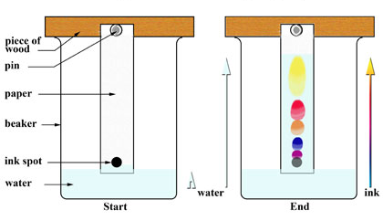
Chromatography
Is a technique used to separate the components of a mixture
Often used to separate dyes in paper chromatography

Slide 146
Paper chromatography
Reference spots are dipped in solvent and over time the solvent moves up paper and separating components based on solubility.
Based on capillarity
Some components move fast, some slowly

Slide 147
Paper is the stationary phase – doesn’t move
Solvent is the mobile phase – does move

Slide 148
The more soluble the component the further it travels up the stationary phase.

Slide 151
Factors that affect solubility
Size – the larger the molecule, the harder it is for it to get through the paper. Smaller molecules can move faster
Polarity – in a polar solvent, polar molecules will rise faster than less polar molecules

Slide 152
Uses
Can be used to tell how far a reaction has gone on

Slide 153
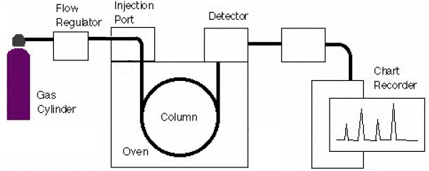
Other chromatography
Gas liquid chromatography (GLC)
Mobile phase is an inert gas (nitrogen or helium)
Stationary phase is a high boiling point liquid on an inert solid

Slide 154
Volumetric Analysis

Slide 155
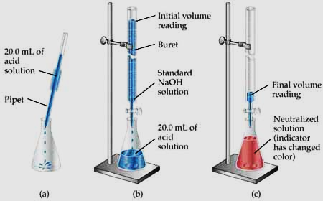

Slide 156
Why use it?
Great for neutralisations
Can use results to calculate info on the reactants, like concentrations
Needs a standard solution – the solution of known concentration
Neutralisation is shown by a change in colour of an indicator
Not always needed if ions have colours
Neutralisation is the end point of the reaction

Slide 157
Redox Titrations

