Slide 1
Revision
Higher Chemistry in Society

Slide 2
Percentage Yield
The yield is how much of the desired final product you make
% Yield compares what you expected to produce with what you actually made

Slide 3
% Yield = Actual mass of product x 100
Theoretical mass of product
What is the % yield if theoretically 56g of cyclohexane should be formed, but during the chemical synthesis only 28g of cyclohexane are made
(28/56) x 100 = 50.00%
In theory, 5.6g of calcium oxide should be made but actually only 4.8g are formed
(4.8/5.6) x 100 = 85.71%
3) A chemical reaction that should make 10.0g of magnesium oxide only makes 4.0g. What is the % yield?
(4.0/10.0) x 100 = 40.00%

Slide 4
Model Answer:
In order to calculate the theoretical yield you need to be able to complete the following steps
1) Write down a balanced symbol equation
CaCO₃ CaO + CO₂
2) Work out the relative formula mass of the reactants and products
CaCO₃ CaO + CO₂
100 56 44
3) Times the relative formula masses by how many molecules there are of the respective chemical
CaCO₃ CaO + CO₂
100 x 1 56 x 1 44 x 1
4) Scale the quantities to the correct amount
If 50g of CaCO₃ were used (half of 100), then 28g of CaO would be made (half of 56)

Slide 5
ATOM ECONOMY is the mass of the product you want as a % of the mass of all the products you make
REACTANTS
PRODUCTS
+
Stuff you also get but don’t want
Stuff you want
ATOM ECONOMY about 50%

Slide 6
CALCULATING ATOM ECONOMY
Often, chemical reactions produce unwanted products along with the product you want.
ATOM ECONOMY is the mass of product you want as a % of the mass of all the products you make
Useful product
Waste product
CaCO₃ = CaO + CO₂
RFM: 100 56 44
ATOM ECONOMY
mass useful product
mass of all products
=
X 100%
Atom Economy = 56 / (56 + 44) = 56 / 100 = 56 %

Slide 7
ATOM ECONOMY is the mass of product you want as a % of the mass of all the products you make
RAM
Mg 24 Fe 56 C 12
O 16
2Mg + O₂ → 2MgO
RFM: 48 32 80
Atom Economy = 80 / 80 x 100% = 100 % (obviously)
Fe₂O₃ + 3CO → 2Fe + 3CO₂
160 84 112 132
Atom Economy = 112 / 244 x 100% = 45.9 %

Slide 8
SUMMARY
% YIELD is the amount of product you actually make as a % of the amount you should theoretically make
ATOM ECONOMY is the mass of the product you want as a % of the mass of all the products you make
% YIELD ABOUT 75%
Stuff you also get but don’t want
Stuff you want
ATOM ECONOMY about 50%
SHOULD make this much
ACTUALLY make this much

Slide 9
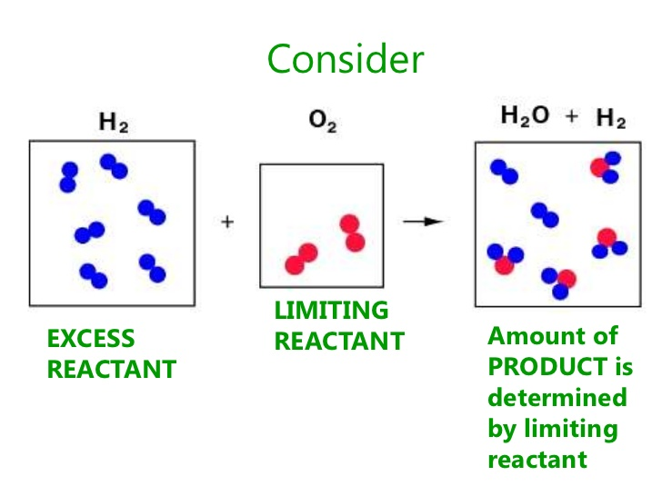
Limiting Reactants:
More often than not, when you carry out a reaction in experiments, you do not use the exact amounts of reactants as predicted in the balanced equation. One of the reactants will be in excess.
For example, if you add dilute hydrochloric acid to magnesium ribbon, hydrogen gas is given off and you see bubbles rising from the magnesium. If the reaction stops (no more bubbles of gas appear) but there is still magnesium ribbon – the magnesium is in excess.
The reason the reaction stops is that all of the acid has been used up. In this case the acid is called the limiting reactant.
The reactant that gets used up first in a reaction is called the limiting reactant (or limiting reagent).
You can work out which is the limiting reactant from the balanced equation, if you know the number of moles of reactants you start with…

Slide 10
Worked example:
If you have 4.8g of magnesium ribbon reacting in a solution of dilute hydrochloric acid containing 7.3g of HCl, which reactant is the limiting reactant?
Step 1: Write the balanced equation for the reaction.
Mg(s) + 2HCl(aq) → MgCl₂(aq) + H₂(g)
Step 2: Calculate the number of moles of reactants in the reaction from the give masses.
No. of moles = mass / Ar or Mr
Mg = 4.8 / 24 = 0.2mol
HCl = 7.3 / (1 + 35.5) = 0.2mol
Step 3: What is the mole ratio reacting together in the balanced equation? Use this to work out which is the limiting reactant in this equation.
From the balanced equation 1 mole of Mg will react with 2 moles of HCl.
Therefore 0.2mol of Mg would need 0.4mol of HCl to react completely.
HCl is the limiting reactant as there is only 0.2mol of HCl available, not enough to react completely with 0.2mol of Mg.

Slide 11
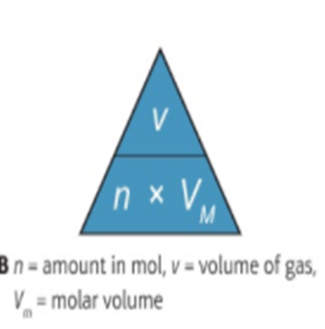
Molar Volume

Slide 12
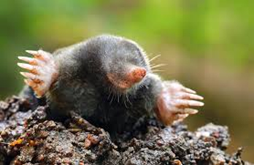
Gas Volumes When Solids and Solutions are Involved
Calculate the volume of hydrogen gas produced when 0.75g of Mg reacts with excess HCl. Assume Vm = 23.9mol.l
Work out mole ratio from balanced equation Mg + 2HCl → MgCl₂ + H₂
Calculate number of moles of Magnesium reacting – n = m/GFM – 0.75/24.3 = 0.031 mol
Calculate the volume of gas produced from mole:Vm ratio – 0.031 x 23.9 = 0.74 l

Slide 13
Equilibria – Worksheet 3
Change in reaction | Movement of equilibrium
Concentration Addition of reactant/removal of product Addition of product/removal of reactant | Shifts right to the product’s side Shifts left to the reactant’s side
Temperature Increase Decrease | Shifts to favour the endothermic reaction Shifts to favour the exothermic reaction
Pressure Increase Decrease | Shifts in direction of less gaseous moles Shifts in direction of more gaseous moles
Catalyst | No effect on position, but equilibrium is reached quicker

Slide 14
Enthalpy of Combustion
Knowing the enthalpy change when a substance burns completely in oxygen is useful for calculating how effective a fuel might be
Enthalpy change given in data booklet is for 1 mole of a substance burning completely at 25° and 1 atmosphere of pressure – standard enthalpy of combustion ΔH_{c}
Eh = c x m x ΔT
Exothermic reactions will have a negative value

Slide 15
Enthalpy of Combustion Reactions
50 cm3 of 1 mol/l HCl was mixed with the same volume and concentration of NaOH. The temperature rise was 6.3°C – what was the enthalpy change when 1 mole of water is produced?
Work out the energy transferred to the water: m = 50 + 50 = 100 cm³ = 100g = 0.1 kg. E_{h} = c x m x ΔT = 4.18 x 0.1 x 6.3 = 2.63 kj
Calculate the number of moles of acid (or alkali) used: moles = concentration x volume = 1 x 0.05 = 0.05 mol – we know from the balanced equation that everything is at a 1:1:1 ratio so 0.05 moles of water is formed
Work out the energy transferred when I mole of water is formed: When 0.05 moles of water is made, 2.63 kj of energy is released so when 1 mole is formed the enthalpy change is 2.63/0.05 = - 52.7 kj/mol/l

Slide 16
Estimating Enthalpy Changes
Can use bond enthalpies to estimate enthalpy changes for different reactions
Enthalpy of a reaction is the difference between the energy needed to break bonds and the energy released when bonds are made
For example, when a fuel burns the energy produced when the bonds are made is greater than the energy needed to break the bonds between the reactants
EX: Burning Hydrogen in Oxygen
Bond Breaking Bond Making
H-H + ½ O=O → H-O-H
436 + ½ (498) → 2 (-463)
ΔH = 436 + 249 + (-926)
= -241 kj/mol/l
Bond Enthalpies (kj/mol/l)
C-H = 412
C-O = 360
O-H = 463
O=O = 498
C=O = 743

Slide 17
Overall Energy Change = Energy needed - Energy given out
to break bonds when bonds form
If the energy needed to break the bonds is higher, then the overall energy change is positive. More energy is taken in than released therefore the reaction is Endothermic
If the energy given out during bond formation is higher, then the overall energy change is negative. More energy is released than taken in therefore the reaction is Exothermic

Slide 18
O
H
H
H
H
O
O
O
H
H
H
H
2H₂ + O₂ 2H₂O

Slide 19
O
H
H
H
H
O
O
O
H
H
H
H
2H₂ + O₂ 2H₂O
Energy needed to break bonds
(2 x H – H) + (1 x O = O)
(2 x 436) + (1 x 498) = 1370

Slide 20
O
H
H
H
H
O
O
O
H
H
H
H
2H₂ + O₂ 2H₂O
Energy needed to break bonds
(2 x H – H) + (1 x O = O)
(2 x 436) + (1 x 498) = 1370
Energy released
(4 x O – H)
(4 x 464) = 1856

Slide 21
O
H
H
H
H
O
O
O
H
H
H
H
2H₂ + O₂ 2H₂O
Energy needed to break bonds
(2 x H – H) + (1 x O = O)
(2 x 436) + (1 x 498) = 1370 kJ/mol
Energy released
(4 x O – H)
(4 x 464) = 1856 kJ/mol
Overall Energy Change = Energy needed - Energy given out
to break bonds when bonds form
= 1370 – 1856 = - 486 kJ/mol -ve therefore exothermic

Slide 22
Hess’s Law
Hess’s Law = the enthalpy change for a chemical reaction is independent of the route taken from reactant to products, so long as the starting and finishing conditions are the same for each route
We can use this is work out the enthalpy change of formation of methane, which cannot be made directly from its elements – Hess’s law allows us to calculate enthalpy of formation using indirect routes
We can use the enthalpies of combustion of Carbon, Hydrogen and Methane to calculate the enthalpy of formation – the enthalpies of combustion are from the data booklet

Slide 23
Formation of Methane
C + O₂ → CO ΔH1 = -394 kj/mol/l
H₂ + ½ O → H₂O ΔH2 = -286 kj/mol/l
CH₄ + 2O₂ → CO₂ = 2H₂O ΔH3 = -891 kj/mol/l
Route 1 is our target equation
Route 2 is the indirect route – CO₂ + 2H₂O → CH₄
ΔH1+ ΔH2 + ΔH3
ΔH2 has to be multiplied by 2 as the target equation has 2 moles of H reacting
ΔH3 has to be reversed as carbon dioxide and water combine to form methane and oxygen (the opposite of combustion)
-394 + (2 x -286) – (-891) = ΔH_{f} -75kj/mol/l

Slide 26
Cu²⁺ (aq) + → Cu (s) reduction
O²⁻(aq) - → O₂(g) oxidation
Li⁺(l + → Li(s) reduction
2H⁺(aq) + → H­₂(g) reduction
Mg²⁺ (s) + → Mg(s) reduction
Al³⁺(l) + → Al (s) reduction
2e-
2e-
e-
2e-
2e-
3e-

Slide 27
Completing Half Equations
To balance O add water
To balance H add Hydrogen ions
EX: BrO⁻ (aq) + 2e → Br⁻
BrO- + 2e → Br- + H₂O
BrO⁻ + 2H⁺ + 2e → Br⁻ + H₂O
Bromine has been reduced – reduction reaction
Oxidation shown by loss of electrons

Slide 28
Redox Equations
Convert the unbalanced redox reaction to the ionic form( may already be done
Write 2 half equations for the oxidation and reduction
Balance all atoms except for O and H
Balance Oxygen – in acidic solutions balance by adding water
Balance Hydrogen by adding H ions
Balance the ionic charge by adding electrons
Balance electron loos with electron gain between the 2 half reactions
Add the 2 reactions together and cancel anything that appears on both sides
Make sure all atoms and charges are balances

Slide 29
Use of Oxidising Agents
Hydrogen Peroxide: - breaks down coloured compounds so used as a bleach
Potassium Permanganate: antiseptic, disinfectant, treatment of mild skin conditions/fungal infections, water treatment to remove iron/hydrogen sulphide and kill algae

Slide 30
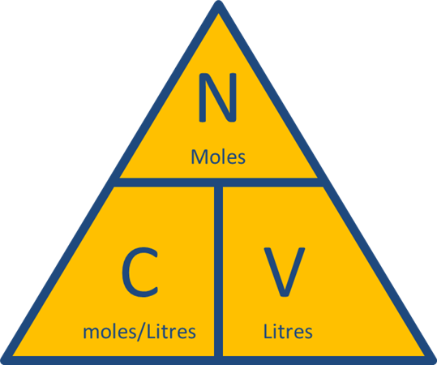
Concentration from Titrations
(volume x concentration)/moles of acid = (volume x concentration)/moles of alkali
Must convert to l!
Reactions involving potassium permanganate don’t need an indicator, it is self-indicating

Slide 31
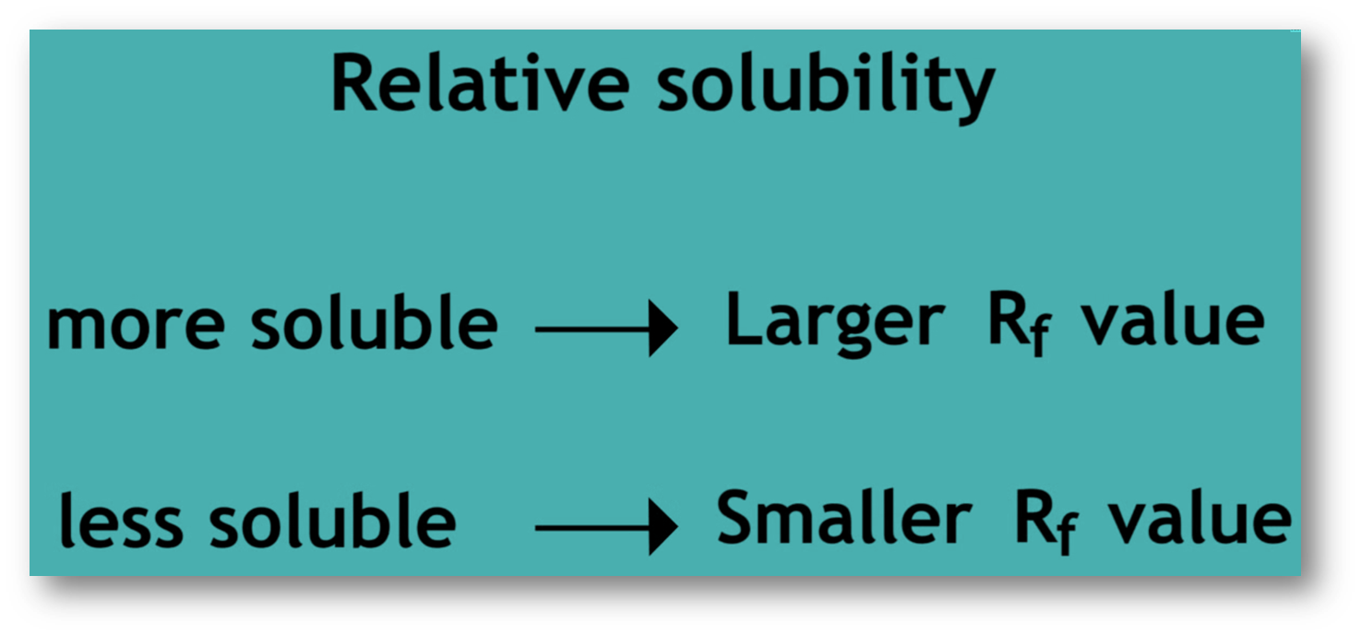
Rf Values
Rf = distance travelled by the compound/distance travelled by the solvent
Rf values have no units
Different compounds will have different Rf values – this value will be constant IF other conditions e.g. paper, solvent, are kept the same
For molecules with similar polarity the larger the molecule the smaller the Rf value – the slower it will move up the plate
A polar molecule will have a higher Rf value in polar solvents than if a non-polar solvent is used

Slide 32
Example: Identifying Amino Acids
Sometimes amino acids in a mixture are not completely separated because they have similar solubilities in a particular solvent – paper is rotated 90° and a different solvent used - 2 way separation
The mixture and known amino acids are spotted on the paper, baseline drawn in pencil
As the solvent moves up the paper the amino acids move with it and separate out – at this stage the amino acids are invisible
When the solvent reaches the top of the paper, the paper is removed, dried and sprayed with ninhydrin to make the amino acids spots appear purple
Repeat the separation using a different solvent

Slide 33
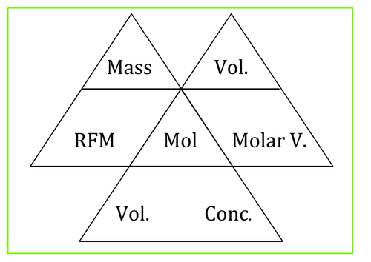
Useful Equations
m = mass (g)
n = moles (mol)
Mr = relative atomic mass
C = concentration (mol/l)
V = volume (l)
Vm = molar volume = (dm3)

