Slide 1
Inclusive Sports and Physical Activity for Participants with Disabilities.
LO1

Slide 2
The purpose of this outcome is to develop learner’s knowledge of the systems and agencies that support progressive inclusive sports coaching.
This includes an in depth look at classification, eligibility and equipment modifications.

Slide 3
Resources
For much of todays lesson you will be in groups (number within each group to be decided on the day)
Each group will have flip chat paper and pen(s) to take notes for revision purposes.
Design your notes based on a group decision, i.e bullet points with sub-headings, mind maps etc.
An individual task will follow.

Slide 4
What is a disability?
In groups, come up with your own definition for ‘disability’?

Slide 5
What is a disability?
Definition in accordance with the Equality Act 2010...
“If someone has a physical or mental impairment and the impairment has a substantial and long-term adverse effect on his or her ability to carry out normal day-to-day activities.”

Slide 6
Classification – what does it mean? Please take notes in your groups!

Slide 7
Agencies that support progressive inclusive sports coaching
Paralympic – ParalympicsGB
Special Olympics - Special Olympics
British Blind Sport - Home | British Blind Sport
Scottish Disability Sport - Home - (scottishdisabilitysport.com)
British Deaf Sport - Home - UK Deaf Sport
Cerebral Palsy International Sport and Recreation- Association - World Abilitysport - we see ability

Slide 8
For each of the agencies and organisations on the previous slide you are to research and take notes on the following : (using your flip chart paper)
What does each organisation do?
What is their mission, values or ethos statement?
Can you provide any information based on classification?
Can you provide any information based on equipment modifications?

Slide 9
Individual task
Now you are to create a word document and title this Learning outcome 1 assignment with the following subheadings :
Agencies & organisations
Progression routes
Rule and equipment modifications
Eligibility & classifications
* please begin to populate any headings you are able to at this stage from the task(s) already completed this morning and ensure you are putting your information in your own words (paraphrasing).

Slide 10
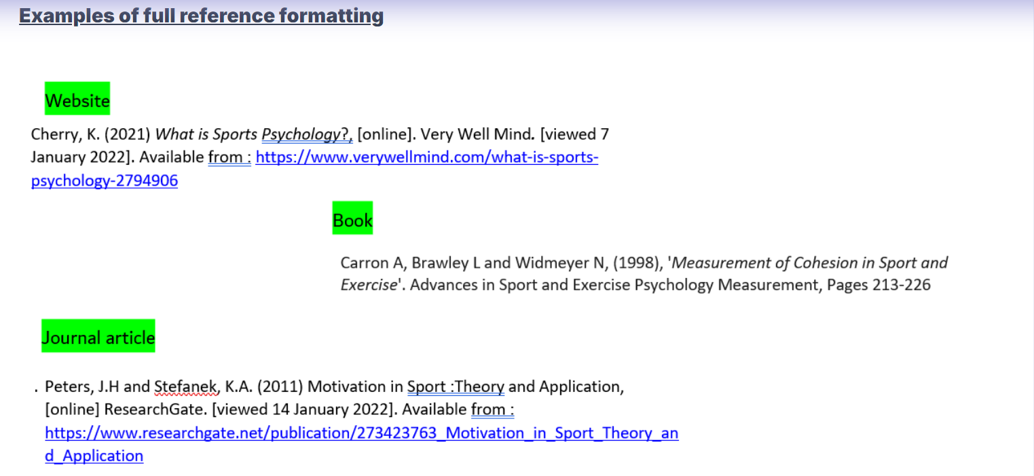
Individual task
Now for each of the websites or other sources used so far today you are to make an attempt at listing your references at the bottom of your LO1 word document.
To help you get started – depending on which type you have accessed please copy the template from below and apply to your research links …..your tutor will discuss this with you.

