Slide 1
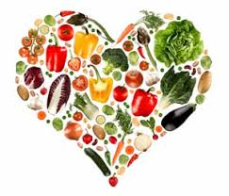
Nutrition, Health and Wellbeing
Vitamins

Slide 2
Aims and Objectives
LO1- Identify the key elements of nutrition in relation to a healthy, balanced diet.

Slide 3
Vitamins
Vitamins are organic compounds which are essential for normal growth and nutrition and are required in small quantities in the diet because they cannot be synthesized by the body.
There are currently 13 recognised Vitamins

Slide 4
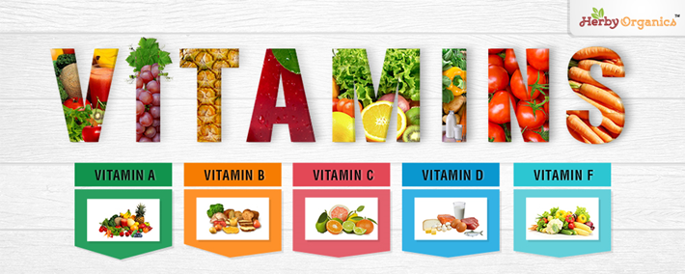

Slide 6
Vitamins
Vit A is needed for Vision
B1 and B2 helps release energy
B3 needed for cell growth
B5 produces energy and hormones
B6 essential for formation of red blood cells
B7 needed to metabolize proteins, carbs & fat.
B9 essential for making DNA and RNA
B12 helps nervous system
Vit C – collagen production, wound healing and bone formation.
Vit D essential for bone growth and development
Vit E protects against inflammation and disease
Vit K necessary for blood clotting
Medical News Today, 2020.

Slide 7
Red Meat
Milk
Cheese
Vitamins
Fish
Fruit

Slide 8
Physical Effects
Excess
Feeling Sick and being Sick
Weight Loss
Osteoporosis
Deficiency
Weak Teeth
Poor Bones
Muscle Pain or Weakness

Slide 9
Psychological Effects
Excess
Increase in Sanity
Deficiency
Depression
Seasonal Affective disorder
Reduced Self Esteem

Slide 10
Emotional Effects
Excess
Worry
Frustration
Deficiency
Worry
Lack of Confidence
Discomfort

Slide 11
Any questions?

