Slide 1
Calculations from equations
N6 Chemistry in society
Niall Crawford

Slide 2
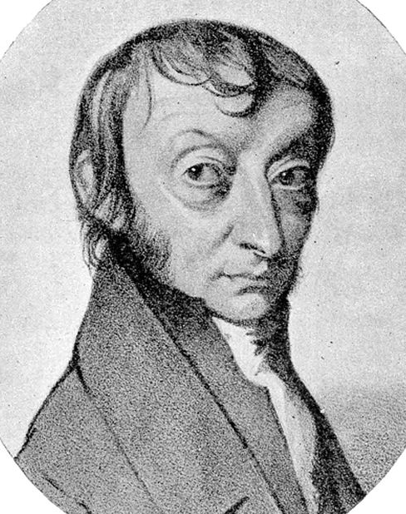
CALCULATIONS
Avogadro’s Constant
Amedeo
Avogadro
One mole of a substance contains
6.02 x 10²³
formula units

Slide 3
CALCULATIONS
Avogadro’s Constant
= 6.02 x 10²³
Amedeo
Avogadro
molecules in 2moles of H₂ gas?

Slide 4
CALCULATIONS
Avogadro’s Constant
= 6.02 x 10²³
Amedeo
Avogadro
1.204 x 10²⁴ molecules

Slide 5
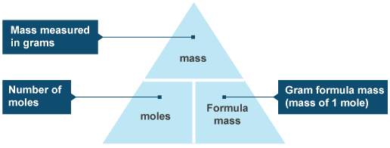
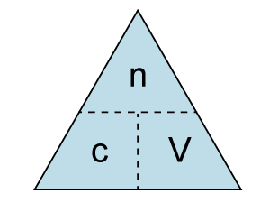
Reminder
Remember these…?

Slide 6
Chemists will need to use chemical equations to work out how their product can be made efficiently
Needs a balanced equation, including number of moles
Examples on page 133 and 134, get stuck in
Sometimes both equations are used (one is useful for solids, the other for solutions) – p135

Slide 7
Calculations with excess reactant
This is working out which reactant will dictate how much product is made
Calculate which reactant is in excess
The one in excess doesn’t limit the reaction

Slide 8
LIMITING REACTANT
C₆H₈O₆ + I₂ → C₆H₆O₆ + 2H⁺ + 2I⁻
25 cm³
0.1 mol l⁻¹
0.0025 moles
0.27 g
Mass
n
FM
0.27g
253.8 g/mol
=
n =
0.001 moles

Slide 9
LIMITING REACTANT
C₆H₈O₆ + I₂ → C₆H₆O₆ + 2H⁺ + 2I⁻
25 cm³
0.1 mol l⁻¹
0.0025 moles
0.27 g
0.001 moles
Ratio of reactants required
1mol
1mol
=

Slide 10
LIMITING REACTANT
C₆H₈O₆ + I₂ → C₆H₆O₆ + 2H⁺ + 2I⁻
25 cm³
0.1 mol l⁻¹
0.27 g
Ratio of reactants available
0.0025mol
0.001mol
=

Slide 11
LIMITING REACTANT
C₆H₈O₆ + I₂ → C₆H₆O₆ + 2H⁺ + 2I⁻
0.0025mol
0.001mol
NOT ENOUGH I₂
I need a ratio of 1 to 1 to make reaction happen.

Slide 12
Excess reactants
Read examples on p135/136
Questions on p136

Slide 13
Calculations involving gases
When reactants or products are gases, volume rather than mass is appropriate to measure
We should consider the volume of 1 mole of gas – the molar volume (l mol⁻¹)
Experimental setup on fig. 12.1
Mass of gas calculated
Volume of flask calculated
See worked example 6 to show this is done…
Molar volume, at 20°C and 1 atmospheric pressure, is 24 litres per mol for any gas

Slide 14
Why is the molar volume the same for all gases?
Gases have a high kinetic energy and are far apart
The volume doesn’t depend on the size of the actual molecules like in solids or liquids
Gases don’t take up a lot of space – only 0.1% in a room temp and pressure room.
You are usually told the molar volume (especially if it varies from 24)

Slide 15
If the molar volume is known, the volume of the gas can be calculated from the no. of moles of gas
Yes, it’s a triangle
Volume (litres)
number of MOLES
V
Molar
Volume
(l mol⁻¹)
n
MV

Slide 16
Examples…
P138, worked example 7 and question 13

Slide 17
Using molar volume in calculations
Can be used in a couple of ways
Firstly, can be used when there is one gas, and conjunction with the other formulae we know
Some good examples on page 138

Slide 18
Comparing volumes of gases
Deals with reactions where more than one gas is involved, and the volumes can be compared
Example from the book:
2CO(g) + O₂(g) →2CO₂(g)
2 moles of carbon monoxide combines with 1 mole of oxygen to make 2 moles of carbon dioxide
If the experiment took place in the same temp and pressure, then the volumes of the carbon monoxide and dioxide should be the same, with the oxygen volume being half (think about the triangle)
2 litres CO + 1 litre O₂ makes 2 litres CO₂
See worked example on p139, questions on p140

Slide 19
Gas volume calculations involving excess reactants
Again, we want to work out which reactant is in excess – i.e. not the limiting factor
Worked example 10 and 11

