Slide 1
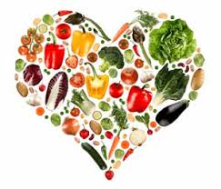
Nutrition, Health and Wellbeing
PROTEINS

Slide 2
Aims and Objectives
LO1- Identify the key elements of nutrition in relation to a healthy, balanced diet.

Slide 3
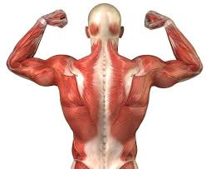
Protein
Needed to maintain, build and repair cells in the body – They are necessary for the proper structure and functions of tissues and organs.
Body can’t store excess protein (it stores as fat) and therefore needs a daily in take.
If possible, consuming a variety of complete proteins is recommended. A complete protein is a protein that contains a good amount of each of the nine essential amino acids required in the human diet.

Slide 4
Protein
Protein needs per day = 0.8g per Kg body weight per day
Person Weighs 60Kg
0.8g x 60Kg = 48g (desirable protein intake).
This value is the minimum recommended to maintain basic nutritional requirements.
This can range from 0.8g/kg – 1/8g/kg of body weight dependant on many factors such as age, weight, activity level.

Slide 5
Protein
Recommended dietary allowance of protein, based on age
 | Protein Needed (grams/day)
Age 1 -3 | 13
Age 4 -8 | 19
Age 9 – 13 | 34
Age 14 – 18 (Girls) | 46
Age 14 – 18 (Boys) | 52
Age 19 – 70 (Women) | 46
Age 19 – 70 (Men) | 56

Slide 6
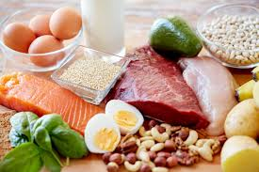
Protein
What foods are protein?

Slide 7
Meat
Lentils
Nuts
Poultry
Milk
Protein Foods
Cheese
Brown Rice
Fish
Beans and Pulses
Eggs
Pasta
Whole Wheat

Slide 8
Physical Effects
Excess
Fluid imbalance
Storage of Fat
Lead to Kidney damage
Deficiency
Abnormal Growth and tissue development
Reduce function of immune system
Weight Loss

Slide 9
Psychological Effects
Excess
Depression
Unease
Deficiency
Depression
Anxiety
Limited Stress Tolerance

Slide 10
Emotional Effects
Excess
Confusion due to body changes
Possibly feeling low about changes
Deficiency
Confusion due to body changes
Possibly feeling low about changes.

Slide 11
Any questions?

Slide 12
Additional Info
Examples of complete protein foods or meals include:
Meat/Dairy examples | Vegan/plant-based examples
Eggs | Buckwheat
Chicken breast | Hummus and pita
Cottage cheese | Soy products (tofu, tempeh, edamame beans)
Greek yogurt | Peanut butter on toast or some other bread
Milk | Beans and rice
Lean beef | Quinoa
Tuna | Hemp and chia seeds
Turkey breast | Spirulina
Fish
Shrimp

