Slide 1
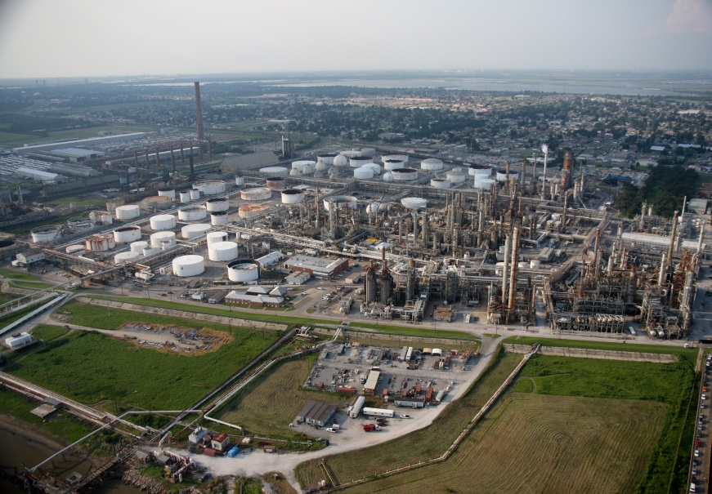
Getting the most from reactants: designing an industrial process
N6 Chemistry in society
Niall Crawford

Slide 2
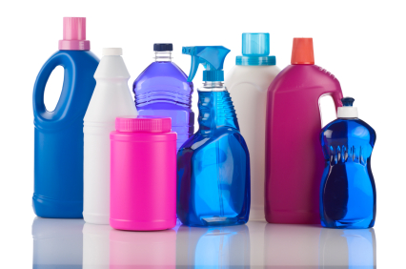
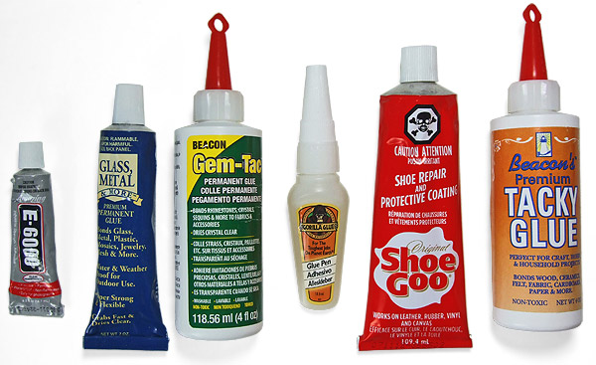
Introduction
Chemists are constantly looking for ways that chemicals can benefit us in society

Slide 3
Examples
Disinfectants
Polishes and cleaners
Vet health products
Inks and pigments
Treating chemicals
Synthetic fibres
Pesticides
Plastics
Paints
Detergents
Explosives
Adhesives
Pharmaceuticals
Aerosols
Fertilisers
Herbicides
Cosmetics and toiletries

Slide 4
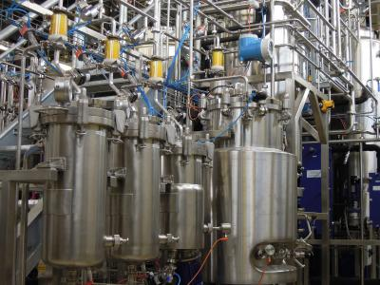
Chemical industry
These chemicals are made on an industrial scale – large amounts!
Needs to be done with minimum waste, and maximum profit

Slide 5
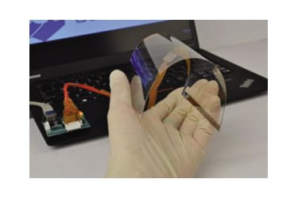
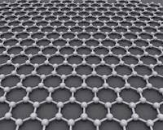
New product creation
Companies can potentially make loads of money from developing a novel product
Either brand new, or ‘better’ products
Several factors involved in developing that…

Slide 6
Considerations
Availability, sustainability and cost of feedstock
Recycling
Energy requirements
Use of by-products
Yield of product

Slide 7
Availability, sustainability and cost of feedstock
Local feedstocks keep cost down
Far afield feedstock will cost more
Also safety and environmental concerns
Are stocks going to become scarce? Can become too expensive
E.g. oil and gas prices depending on availability and/or warfare

Slide 8
Recycling
Unreacted chemicals could be fed back in, improves efficiency
Catalysts could be reused
But can be difficult to separate unreacted materials from the product

Slide 9
Energy requirements
Exothermic reactions could be used to heat a building, or another reaction
Catalysts or smaller particle sizes rather than increased temperatures.
When extra heat or cooler temps are needed, this can cost money

Slide 10
By-products
Find a use for by-products!
Eg asphalt from crude oil
If the by-products are toxic or corrosive or damaging, then they can be expensive to get rid of.
Eg sulfur dioxide and carbon dioxide can be costly to deal with

Slide 11
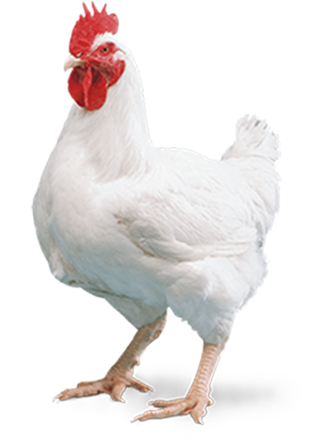
Yield of product
Obviously, high yield is good!

Slide 12
Stages in manufacture of a new product
Research and development
Lab process
Pilot plant
Scaling up
Production plant

Slide 13
e.g. production of ethanoic acid
Route 1: direct oxidation of naphtha
Route 2: from methanol
Naphtha + air Ethanoic acid + several by-products
By-products – propanone, methanoic acid and propanoic acid
Conditions - 180°C; 50 atmospheric pressures
Advantages – single step, by-products sold
Disadvantages – low yield, too many by-products
Methanol + carbon monoxide Ethanoic acid
Conditions - 180°C; 30 atmospheric pressures
Advantages – high yield, flexible with sources
Disadvantages – special materials to make plants needed

Slide 14
Feedstock
A feedstock is a reactant from which other chemicals can be extracted or synthesised
Derived from raw materials – either chemical reaction or physical extraction
E.g. crude oil, air, water
E.g. nitrogen and water (feedstocks) are derived from air (raw material)

Slide 15
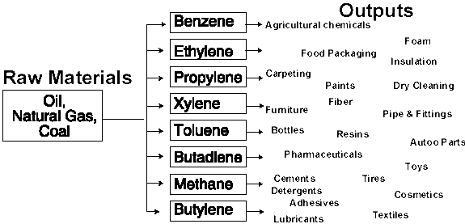
Raw material
Is a substance which is naturally occurring

Slide 16
Environmental considerations
Important to protect the environment
1) minimise waste 2) avoid toxic substances 3) design biogradable
Historically, chemical plants were near the coast, so that waste could go into the sea
Companies now are accountable for their waste
E.g. Billingham
Policies look to minimise waste – fig. 11.6

Slide 17
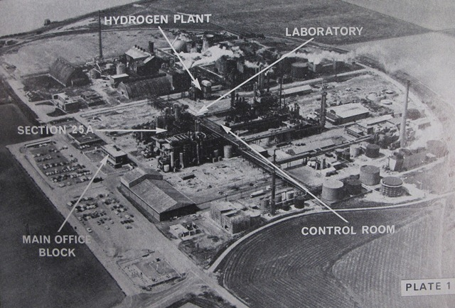
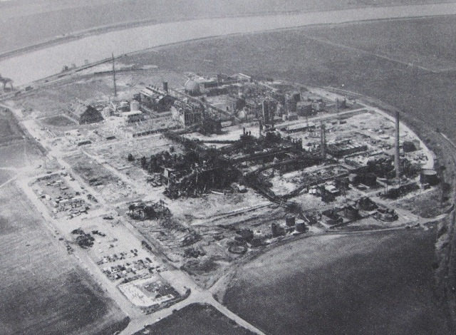
Chemical industry accidents
E.g. p129 – vinyl chloride, and other examples

Slide 18
Investigate…
On page 132, 3 different investigations are listed
Pick one, and read up on it
1) propanone and ethyl ethanoate
2) Bhopal chemical disaster
3) Grangemouth

