Slide 1
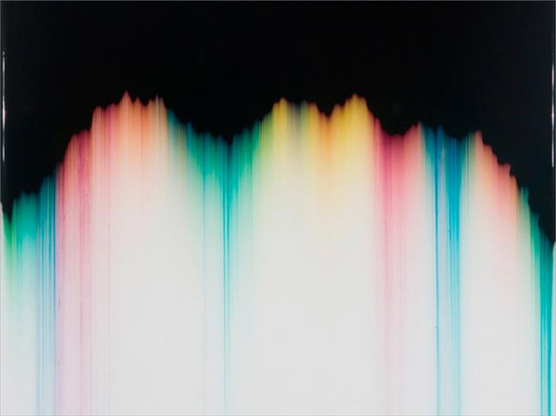
Chromatography and volumetric analysis
N6 Chemistry in society
Niall Crawford

Slide 2
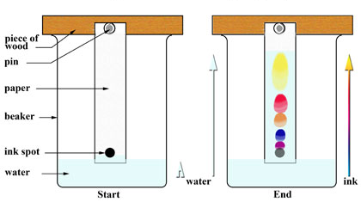
Chromatography
Is a technique used to separate the components of a mixture
Often used to separate dyes in paper chromatography

Slide 3
Paper chromatography
Reference spots are dipped in solvent and over time the solvent moves up paper and separating components based on solubility.
Based on capillarity
Some components move fast, some slowly

Slide 4
Paper is the stationary phase – doesn’t move
Solvent is the mobile phase – does move

Slide 5
The more soluble the component the further it travels up the stationary phase.

Slide 8
Factors that affect solubility
Size – the larger the molecule, the harder it is for it to get through the paper. Smaller molecules can move faster
Polarity – in a polar solvent, polar molecules will rise faster than less polar molecules

Slide 9
Uses
Can be used to tell how far a reaction has gone on
Fig 17.3

Slide 10
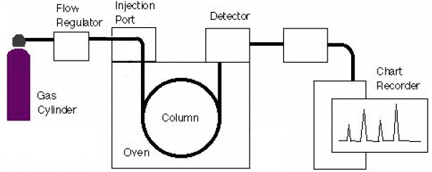
Other chromatography
Gas liquid chromatography (GLC)
Mobile phase is an inert gas (nitrogen or helium)
Stationary phase is a high boiling point liquid on an inert solid

Slide 11
recording
Recording has retention time (time is takes to reach detector) on the x axis, and quantity on the y axis
Fig. 17.7
Read p186 for examples

Slide 12
Volumetric analysis

Slide 13
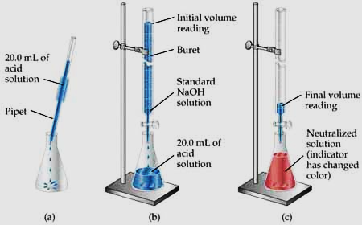

Slide 14
Why use it?
Can control exact amounts of fluids put together
Great for neutralisations
E.g. p190
Gives us info on the reactants, like concentrations
Needs a standard solution – the solution of known concentration
Neutralisation is shown by a change in colour of an indicator
Not always needed if ions have colours
Neutralisation is the end point of the reaction

Slide 15
Neutralisation examples
On page 191
Do questions on p 191

Slide 16
Advantages of volumetric titration method
Easy to carry out
Versatile and reliable
Many reagents are cheap
Vast range of applications

Slide 17
Rules
The reaction must proceed according to a definite chemical equation with NO SIDE REACTIONS.
The reaction should have a very large equilibrium constant.
There must be some method of detecting the equivalence point – an indicator.
The reaction should be rapid!

Slide 18
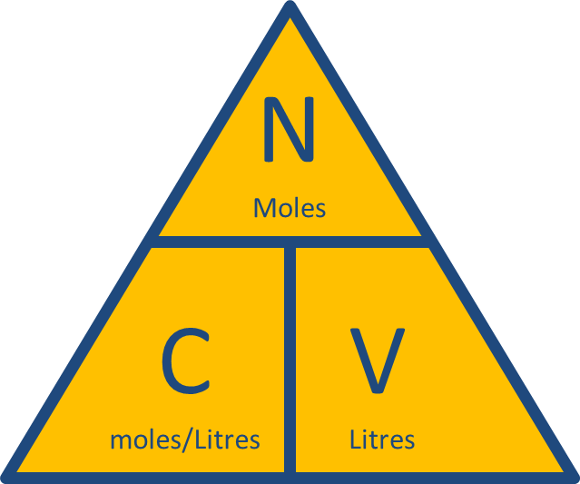
Redox titrations
Can be used for redox reactions too
Need to know the balanced redox equation, and need a indicator to show the end point
Reactions involving potassium permanganate don’t need an indicator, it is self-indicating
The same triangle can be used to solve this
Examples on p192 and 193

Slide 19
Questions
On page 194

