Slide 1
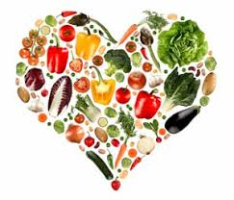
Nutrition, Health and Wellbeing
FATS

Slide 2
Aims and Objectives
LO1- Identify the key elements of nutrition in relation to a healthy, balanced diet.

Slide 3
Fats
A small amount of fat is an essential part of a healthy, balanced diet. Fat is a source of essential fatty acids, which the body cannot make itself.
Fat helps the body absorb vitamin A, vitamin D and vitamin E. These vitamins are fat-soluble, which means they can only be absorbed with the help of fats.
Any fat that's not used by your body's cells or turned into energy is converted into body fat. (Likewise, unused carbohydrates and proteins are also converted into body fat.)

Slide 4
Fats
Some functions of fat -
Fat helps provide healthy skin, hair and nail.
Protection of internal organs – acts like a cushion
Insulation – Thermoregulation (temperature control)
Helps with the regulation of other nutrients

Slide 5
Fats
30% of our diet is made of Fat
Used in endurance activities when body is working aerobically.
Each gram of fat provides 9cals of energy compared to 4cals per gram of Carbs/Protein.

Slide 6
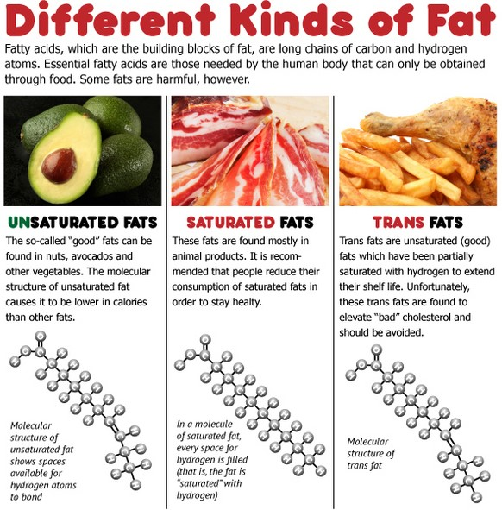

Slide 7
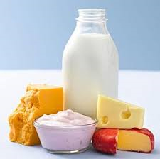
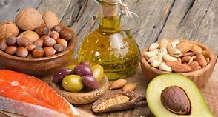
Fats
Saturated
Mainly come from animal sources
Solid at room temp
Unsaturated
Mainly come from plant sources
Liquid at room temp
The Food Standards Agency has proposed changes to food labelling in the UK which will mean that consumers will be able to see the amount of trans-fats in the foods they consume. People can also look at the list of ingredients in their food, if "partially hydrogenated fat/oil" or "hydrogenated fat/oil," is listed, the food contains trans-fat.

Slide 8
Butter
Cream
oils
Nuts
Sugar
Skin on chicken
Fatty Foods
Biscuits
Meat Pies
Oily Fish
Crisps
Cakes
Meats
Cheese
Fried Food
Whole Milk

Slide 9
Physical Effects
Excess
Weight Gain/Obesity
Slow digestion and absorption
Abnormal cholesterol levels
Deficiency
Deficiency in fat soluble vitamins – fat in foods help the intestines absorb these Vitamins – Stored in Liver/Fatty Tissues
Eczema or skin disorders

Slide 10
Psychological Effects
Excess
Depression
Fatigue
Stressed
Possible Low Self-esteem
Deficiency
Depression
Fatigue
Possible POOR SELF IMAGE
Possible signs of obsession

Slide 11
Emotional Effects
Excess
Unhappiness
Need of comfort
Boredom
Anxiety
Guilt
Deficiency
Unhappy
Anxiety
Frustration

Slide 12
Any questions?

Slide 13
OMEGA 3
In general, until scientists conduct further research, it is not clear to what extent omega-3 fatty acids benefit a person beyond the basic maintenance of their body’s cells.
May reduce the chance of heart attack
May reduce inflammation
May help combat obesity
May contribute to infant health
Huzar, T. (2019). What to know about omega-3 fatty acids. [online] Medical News Today. Available at: https://www.medicalnewstoday.com/articles/325179 [Accessed 11 Jan. 2021].

