Slide 1
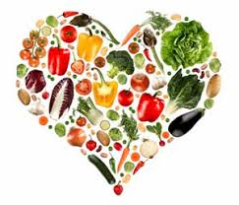
Nutrition, Health and Wellbeing
CARBOHYDRATES

Slide 2
Aims and Objectives
LO1- Identify the key elements of nutrition in relation to a healthy, balanced diet.

Slide 3
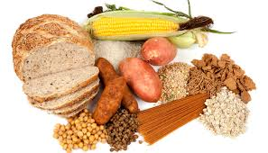
Carbohydrates
Stored in the body as glycogen
Excess carbohydrates are stored as fat
Supply the body with Energy
Energy and Maintenance of blood Sugar levels
2 types – simple and complex
45%-65% of diet

Slide 4
Carbohydrate
Your digestive system converts the carbohydrates in food into glucose, a form of sugar carried in the blood and transported to cells for energy.
Any excess glucose not used by the cells is converted into glycogen and stored in the body as fat.

Slide 5
Carbohydrate
Glycogen is the main source of fuel used by the muscles to enable you to undertake both aerobic and anaerobic exercise.
If you train with low glycogen stores, you may feel tired, training performance will be lower and you will be more prone to injury and illness.

Slide 6
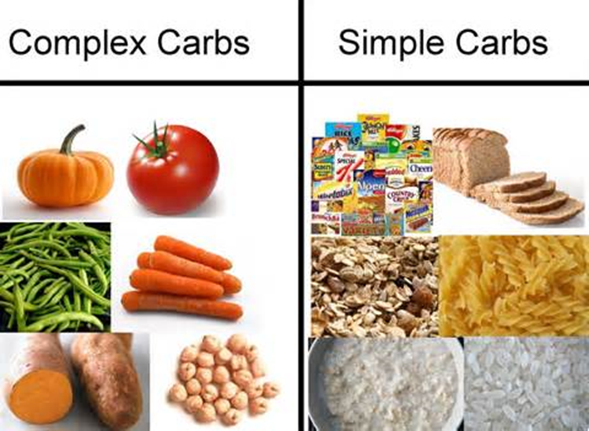
Carbohydrates
What foods are carbohydrates (Carbs?)

Slide 7
Fresh Fruit and Vegetables
Bread
Potatoes
Cereals
Sugar
Beans and Pulses
Carbohydrate Foods
Biscuits
Milk
Yogurt
Crisps
Cakes
Pasta
Dried Fruit
Soft Drinks
Jam and Honey

Slide 8
Physical Effects
Excess
Weight Gain
High Blood Pressure
High Blood Sugar levels High Insulin – insulin tolerance due to constantly eating
Health Problems
Deficiency
Weight loss
Loss of Energy
Breakdown in Protein
Constipation
Nutrition Deficiencies
Sick, Headache, Bad Breath

Slide 9
Psychological Effects
Deficiency
Depression
Anxiety
Limited Stress Tolerance
Lack of Concentration
Excess
Fatigue
Sleepy
Depression
Low Self-Esteem

Slide 10
Emotional Effects
Excess
Feeling Down
Embarrassment
Deficiency
Restless
Irritable

Slide 11
Any questions?

