Slide 1
Nutrition, Health and Wellbeing
Unit Code:- F40G 11

Slide 2
Aims and Objectives
LO1- Identify the key elements of nutrition in relation to a healthy, balanced diet.

Slide 3
Assessment
Learning Outcome 1
Part 2- Open Book assessment (menus)

Slide 4
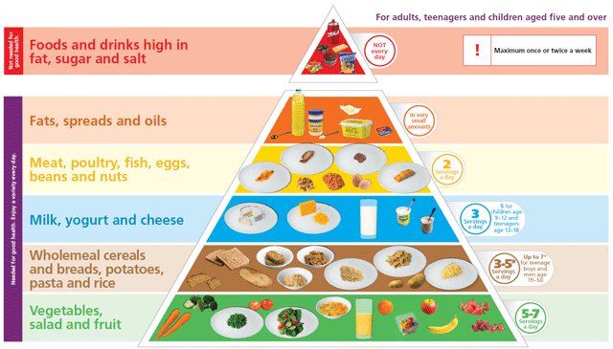
Nutrition
For this assessment you are required to plan 3 days worth of menu’s based on the Food Pyramid.

Slide 6
What do I need to plan?
Breakfast
Lunch
Dinner
Additional information (including snacks).

Slide 7
Breakfast

Slide 8
Lunch

Slide 9
Dinner

Slide 10
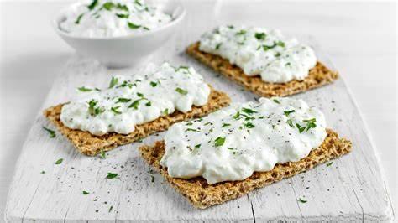
Additional info..

