Slide 1
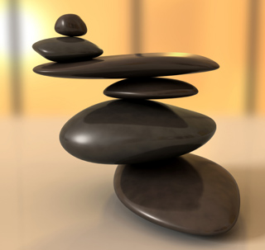
Chemistry in Society Equilibria
Iain Cameron
ICameron@glasgowkelvin.ac.uk

Slide 2
Equilibrium
It is a balance that takes place in a chemical reaction.
During a chemical reaction there is a forward reaction (which is the types of reaction we have covered so far) BUT there is also a reverse reaction.
This is denoted by using equilibrium arrows (⇌) as follows:
Fe³⁺(aq) + CNS⁻(aq) ⇌ FeCNS²⁺(aq)

Slide 3
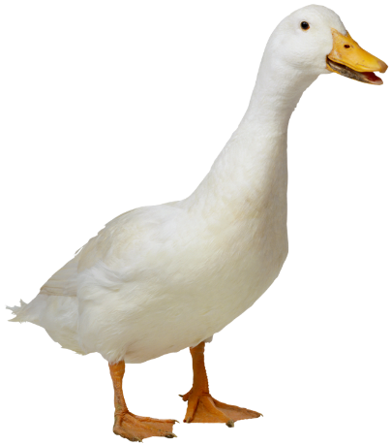
Equilibrium
When the forward and reverse reactions are occurring at the same rate, the reaction is said to be ‘at equilibrium’.
This can only happen in a closed system (a sealed environment) otherwise the concentration of some chemicals will change as the reactions proceed.
At equilibrium, the concentrations of the reactants and products are constant, but are not necessarily equal.

Slide 4
Equilibrium

Slide 5
Shifting the equilibrium
How do you think you might be able to change the state of equilibrium?
Hint: Think back to Unit 1 – Chemical Changes and Structure and rates of reaction…

Slide 6
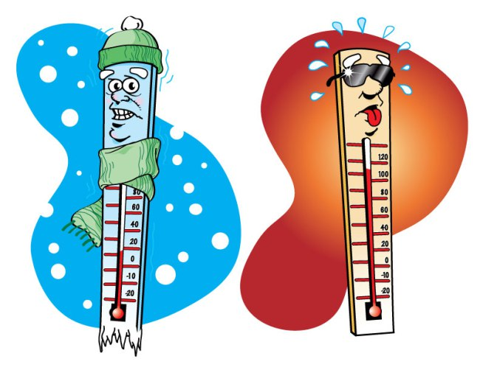
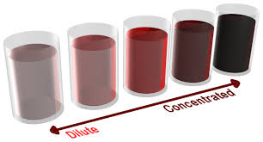
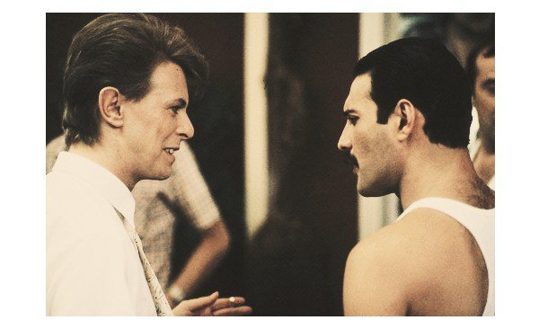
Shifting the equilibrium
The position of the equilibrium can be shifted by altering:
The temperature of the reaction
The concentration of reactants/products
The pressure of the reaction environment

Slide 7
Le Chatelier’s Principle
This states that any change made to the rate of a reaction at equilibrium will result in the equilibrium position shifting to minimise the effect.
Imagine this as a form of diffusion…this will become clearer in a few minutes – promise!

Slide 8
Changing the temperature
Increasing the temperature always favours the endothermic reaction.
Decreasing the temperature always favours the exothermic reaction.
What will happen in each of the following reactions if you increase the temperature?
1. CH₃COOH(l) + CH₃OH(l) ⇌ CH₃COOCH₃(l) + H₂O(l) ΔH = -160kJ mol⁻¹
2. H₂O(l) ⇌ H⁺(aq) + OH⁻(aq) ΔH = +20kJ mol⁻¹

Slide 9
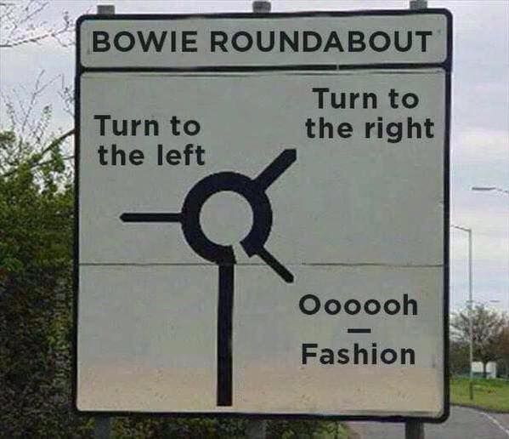
Changing the temperature
Reaction 1 will see the equilibrium shift to the left.
Reaction 2 will see the equilibrium shift to the right.

Slide 10
Changing the concentration
A + B ⇌ C + D
If you increase the concentration of A and/or B, then the rate of the forward reaction increases (more molecules = more collisions = more reactions), which then makes more of C and D until a new equilibrium is established.
Because more products are produced to counteract the increase in reactants, we say that the equilibrium shifts to the right.
Similar to diffusion, right? ;)

Slide 11
Changing the concentration
If we remove the product at a steady rate during a chemical reaction then the equilibrium will, again, shift to the right.
If KCl is dissolved into the following reaction mixture, what can you tell me about the equilibrium?
Cl₂(g) + H₂O(l) ⇌ Cl⁻(aq) + ClO⁻(aq) + 2H⁺(aq)

Slide 12
Changing the concentration
Cl₂(g) + H₂O(l) ⇌ Cl⁻(aq) + ClO⁻(aq) + 2H⁺(aq)
Dissolving KCl into the above reaction mixture will introduce K⁺(aq) and Cl⁻(aq) ions.
This increase in Cl⁻(aq) ions will shift the equilibrium to the left.

Slide 13
Changing the pressure
Increasing the pressure favours the direction which has the lowest total number of moles in the gaseous form.
E.g. increasing the pressure will shift the following reaction to the right:
N₂(g) + 3H₂(g) ⇌ 2NH₃(g)
This is because there are 4 moles of gas on the left (1 of nitrogen and 3 of hydrogen) and only 2 moles of gas on the right.
Equal numbers of moles of gas on both side = no effect when pressure is changed.

Slide 14
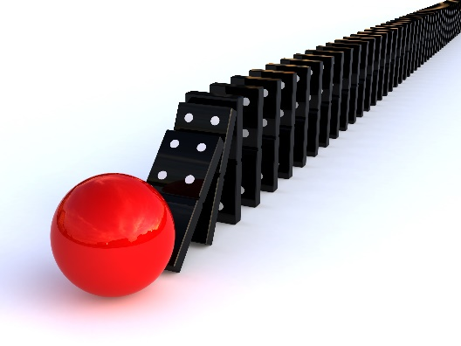
Catalysts and equilibria
As you know, catalysts lower the activation energy required for a successful collision to take place.
This lowers the activation energy for a successful breaking-up of molecules back into reactants as well.
Catalysts, therefore, have no effect on the position of equilibrium BUT it will allow equilibrium to be achieved quicker.

Slide 15
Recap
Change in reaction | Movement of equilibrium
Concentration Addition of reactant/removal of product Addition of product/removal of reactant | Shifts right to the product’s side Shifts left to the reactant’s side
Temperature Increase Decrease | Shifts to favour the endothermic reaction Shifts to favour the exothermic reaction
Pressure Increase Decrease | Shifts in direction of less gaseous moles Shifts in direction of more gaseous moles
Catalyst | No effect on position, but equilibrium is reached quicker

