Slide 1
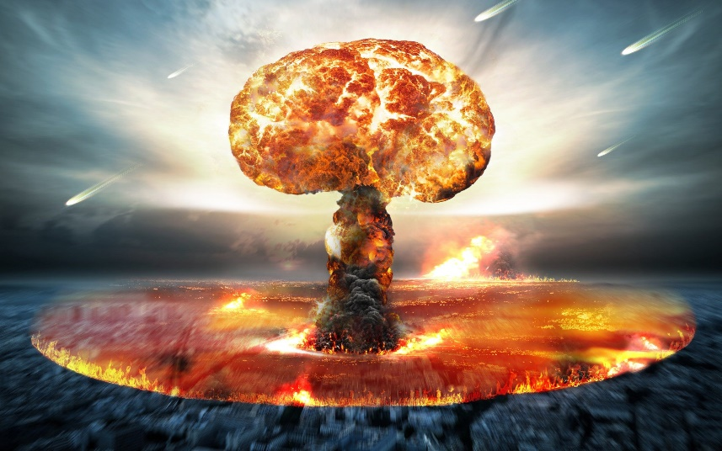
Chemistry in Society Chemical energy
Iain Cameron
ICameron@glasgowkelvin.ac.uk

Slide 2
Exothermic vs. endothermic
In industry, the type of reaction taking place is important.
Endothermic reactions will incur extra costs because you need to supply extra energy for the reaction to absorb.
Exothermic reactions may only need an initial boost of energy until the reaction proceeds and produces enough energy to continue.
Temperatures are monitored continuously to ensure that they remain at safe levels.

Slide 3
Enthalpy
Enthalpy = chemical energy in a reaction.
Energy is used up when bonds are broken.
Energy is released when bonds are formed.
Enthalpy change in a reaction is the difference in energy between the reactants and the products.
The heat used/generate by 1 mole of a compound can be expressed in joules (J) or kilojoules (kJ) mol⁻¹.

Slide 4
Calculating enthalpy change
Use the formula: ΔH = cmΔT
C = specific heat capacity of water.
This value is constant at 4.18kJ mol⁻¹
M = mass of water heated (in kg, remember 1ml or cm³ = 1g).
ΔT = change in temperature in the experiment.

Slide 5
Calculating enthalpy change
A solution was made by dissolving a spatula of potassium nitrate into 70 cm³ of water. The temperature changed from 20.5˚C to 16.7˚C. Calculate the enthalpy change for this reaction.
C = 4.18 (specific heat capacity of water)
M = 0.07 (mass of water in kg)
ΔT = 3.8 (temperature change)
ΔH = cmΔT
ΔH = 4.18 x 0.07 x 3.8 = 1.1kJ mol⁻¹.

Slide 6
Calculating enthalpy of combustion
This simple apparatus can help us work out the enthalpy of combustion in a reaction:
The enthalpy of combustion tells us how much energy is released while burning 1 mole of a fuel.

Slide 7
Calculating enthalpy of combustion
Propanol (C₃H₆OH) was placed in a spirit burner and used to heat 300 cm³ of water in a copper can. When the temperature of the water had increased by 7˚C, the mass of the burner and ethanol had decreased by 0.59 g.
Calculate the enthalpy of combustion of ethanol. (Remember it is the heat given out by 1 mole.)

Slide 8
Calculating enthalpy of combustion
ΔH = 4.18 x 0.3 x 7 = 8.778 kJ mol⁻¹.
This is in 0.59g of propanol, 1 mole of propanol weighs 59g.
0.59g of propanol is 1 hundredth of a mole.
Therefore, we multiply 8.778 by 100 in order to get our final answer.
ΔH = 8.778 x 100 = -877.8 kJ mol⁻¹.
The final number is negative because combustion is an exothermic reaction.

Slide 9
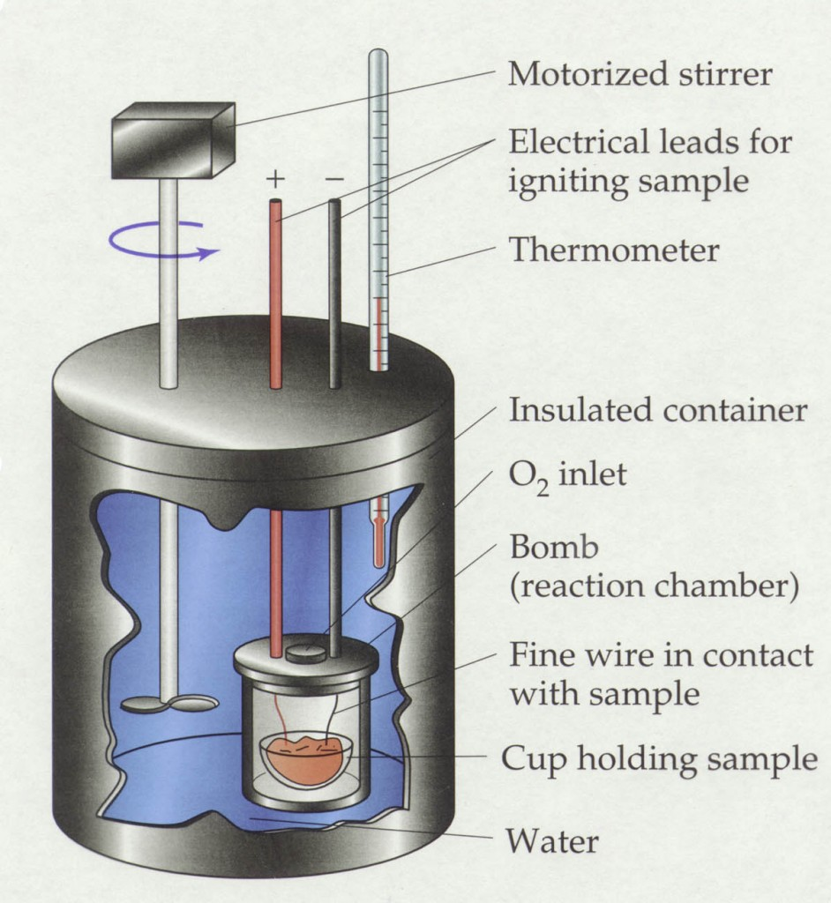
Bomb calorimeter
This apparatus can be used to work out a more accurate enthalpy of combustion:
Why will this make the
readings more accurate?

Slide 10
Bomb calorimeter
It is insulated so heat is not lost to the surroundings.
There is an oxygen inlet so there will be no incomplete combustion.

Slide 11
Enthalpy of neutralisation
This is defined as the enthalpy change of an acid as it is neutralised to form 1 mole of water.
40cm³ of 3 mol l⁻¹ HCl at 17.5°C was neutralised by adding 40cm³ of 3 mol l⁻¹ NaOH at 18.5°C. The highest temperature reached by the resulting solution was 25°C. What is the enthalpy of neutralisation?
Average of starting temperatures = 18°C
Temperature rise = 25 – 18 = 7°C
Total mass of water = 40cm³ + 40cm³ = 80cm³

Slide 12
Enthalpy of neutralisation cont’d
ΔH = cmΔT
4.18 x 0.08 x 7 = 2.34 kJ mol⁻¹.
Next step. Work out for 1 mole of water:
n_{HCl} = 2 mol l⁻¹ x 40 cm³ = 2 x 0.04 = 0.08 moles.
1 mole of HCl = 1 mole of H₂O in neutralisation.
0.08 moles H₂O = 2.34kJ mol⁻¹
1 mole = 2.34kJ mol⁻¹/0.08 = 29.25 kJ mol⁻¹

Slide 13
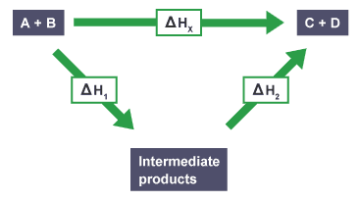
Hess’ Law
Hess’s Law states that the enthalpy change for a chemical reaction is independent of the route taken.
ΔH_{x} = ΔH₁ + ΔH₂

Slide 14
Hess’ Law
Working out enthalpy change using Hess’ Law might involve rearranging sets of equations that you are given with pre-determined ΔH value.
This will require you to remember some things:
The enthalpy change for the process is independent of the route taken (This is Hess’s law).
The enthalpy change is proportional to the quantities of reactants and products. For example, burning twice as much fuel will result in twice the enthalpy change for the process.
If a reaction is reversed then the sign of the enthalpy change must also be reversed.
Changing the physical state of any reactant (or product) will involve an enthalpy change.

Slide 15
Example
Given equations:
Target equation:
What do we have to do to the two top equations to get the reactants and products to the same side as the target equation?

Slide 16
Example
Given equations:
Target equation:
Flip the second equation to get CuO on the left and Cu on the right.

Slide 17
Example
Given equations:
Target equation:
Add equation 1 and the reverse of equation 2
ΔH = -283 + 155 (remember we flipped equation 2 so we change the sign) = -128 kJ mol⁻¹.

Slide 18
Try this question…
This is our target equation:
Using the data booklet (enthalpy of combustion) and the following equation, work out the enthalpy change for the above reaction.

Slide 19
Answer
This is the target equation:
These are your combine equations of combustion:
So to work out the enthalpy change, you need to double equations 1 and 2, and then add the flipped version of equation 3. This means that all compounds in the combustion reactions are in the right number and on the correct side of the reaction arrow. ΔH = 2(-394) + 2(-286) + 876 = -484 kJ mol⁻¹.

Slide 20
Bond enthalpy
Energy is required in order to break bonds.
This means that breaking bonds is an endothermic process.
Energy is released on forming bonds.
This means that forming bonds is an exothermic process.

Slide 21
Bond enthalpy
There are values for this in the data booklet (Pg.10).
The bond enthalpies quoted in the data booklet are the energies required to break one mole of a particular bond between a pair of atoms in the gaseous state.
We can use these to work out the enthalpy change for some reactions.

Slide 22
Example
Using the bond enthalpies in the data booklet, work out the enthalpy change for the following reaction:
H₂ + Cl₂ → 2HCl

Slide 23
Answer
H₂ + Cl₂ → 2HCl
Bond breaking:
H-H → 2H = 436
Cl-Cl → 2Cl = 243
Bond forming:
H + Cl → H-Cl = -432
H + Cl → H-Cl = -432
Total ΔH = 436 + 243 - 432 - 432 = -185kJ mol⁻¹.

