Slide 1
Higher Chemistry Unit 1: Chemical Changes and Structure Oxidising and reducing agents
Iain Cameron
ICameron@glasgowkelvin.ac.uk

Slide 2
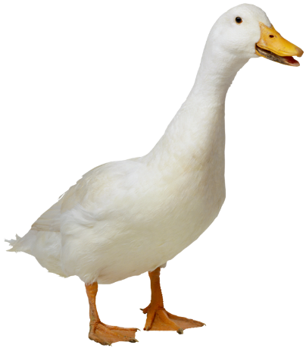
Oxidising agent
These:
Are usually a metal or a negative ion
Lose (donate) electrons to another element or ion (reducing the other species)
Are itself oxidised
Na(s) → Na⁺(aq) + e⁻

Slide 3
Reducing agent
These:
Are normally a non-metal or positive ion
Cause oxidation reactions to take place
Gain electrons from other atoms or ions (is itself reduced)
Cl₂(s) + 2e⁻ → 2Cl⁻(aq)
Cu²⁺(aq) + 2e⁻ → Cu(s)

Slide 4
Redox reaction
When oxidation and reduction reactions happen at the same time, this is known as redox.
Fe³⁺ + 3e⁻ → Fe (red)
Al → Al³⁺ + 3e⁻ (ox)
Al + Fe³⁺ → Al³⁺ + Fe (redox)
The electrons are not shown as they cancel each other out (3 on each side of the equation).

Slide 5
Zinc displacing copper
Oxidation
Zn(s) → Zn²⁺(aq) + 2e⁻
Cu²⁺(aq) + 2e⁻ → Cu(s)
Which reaction is reduction and which is oxidation?
Redox:
Zn(s) + Cu²⁺(aq) → Zn²⁺(aq) + Cu(s)
Which component is the reducing agent and which is the oxidising agent?
Reduction
Reducing
Oxidising

Slide 6
Compounds as oxidising/reducing agents
Look at the electrochemical series shows that compounds can act as oxidising/reducing agents too.
Potassium permanganate is a good example of a strong oxidising agent that is also a compound.
When added to glycerol, a strongly exothermic reaction takes place.

Slide 7
Compounds as oxidising/reducing agents
Carbon monoxide is a really strong reducing agent.
It converts iron (III) ions into iron atoms inside a blast furnace.

Slide 8
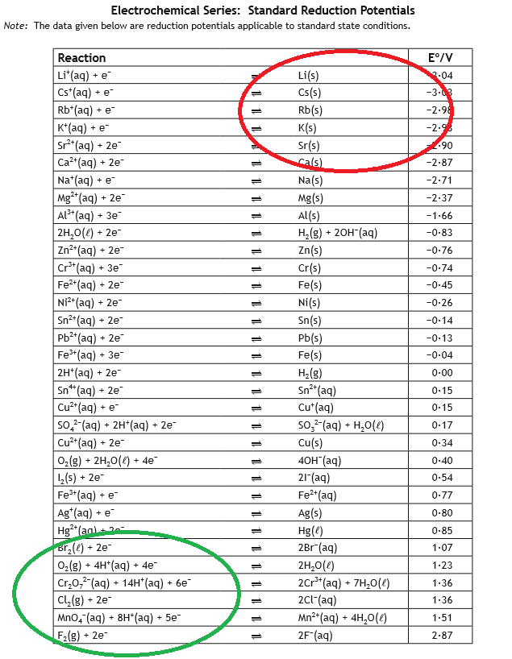
The electrochemical series
This series allows you to predict strong oxidising and reducing agents.
Top right = strong reducing agent
Bottom left = strong oxidising agent

Slide 9
Writing ion-electron equations
You must follow 4 simple rules when writing these equations:
Balance the main element (not oxygen)
Add water to balance oxygen
Add H⁺ to balance hydrogen
Add e⁻ to balance the charges
It’s basically balancing equations 2.0…

Slide 10
Bromine water and sodium sulphite
Br₂ + 2e⁻ → 2Br⁻
SO₃²⁻ → SO₄²⁻ (sodium removed as they are just spectator ions)
The second equation is not balanced. Uhoh…

Slide 11
How to balance it
SO₃²⁻ → SO₄²⁻ (S = balanced anyway)
SO₃²⁻ + H₂O→ SO₄²⁻ (O = balanced by H₂O)
SO₃²⁻ + H₂O→ SO₄²⁻ + 2H⁺ (H = balanced by H⁺)
SO₃²⁻ + H₂O→ SO₄²⁻ + 2H⁺ + 2e⁻ (charges = balanced)
Ta-dah!

Slide 12
Add them together now
Br₂ + 2e⁻ → 2Br⁻
SO₃²⁻ + H₂O→ SO₄²⁻ + 2H⁺ + 2e⁻
________________________________________________
Br₂ + SO₃²⁻ + H₂O→ SO₄²⁻ + 2H⁺ + 2Br⁻

Slide 13
Try this one…
Fe²⁺ → Fe³⁺ + e⁻
MnO₄⁻ → Mn²⁺

Slide 14
And this one…
Cu → Cu²⁺ + 2e⁻
NO₃⁻ → NO

Slide 15
Uses for oxidising agents
Hydrogen peroxide is the most common example that people recognise.
It is used as a bleaching agent e.g. to bleach wool, paper, teeth, hair etc.
It is also an antiseptic that can kill bacteria, fungi and deactivate viruses.
Potassium permanganate can be used as an antibacterial and an antifungal agent e.g. to treat athlete’s foot.

Slide 16
Questions?

