Slide 1
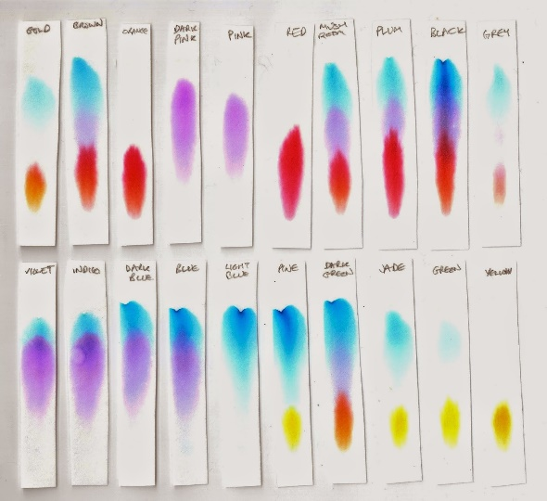
Chemistry in Society Chromatography
Iain Cameron
ICameron@glasgowkelvin.ac.uk

Slide 2
Chromatography
It is a separation technique.
Used frequently to separate the dyes that are found in inks.

Slide 3
Chromatography
This process usually involved a drop of ink (or other mixture) on a piece of chromatography paper. This is called paper chromatography.
This is the partially submerged in a solvent.
The substances present in the original mixture then separate out as the solvent moves up the chromatography paper. Some of the substances move slower than others.

Slide 4
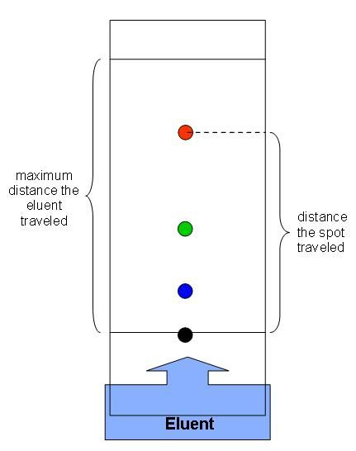
Chromatography

Slide 5
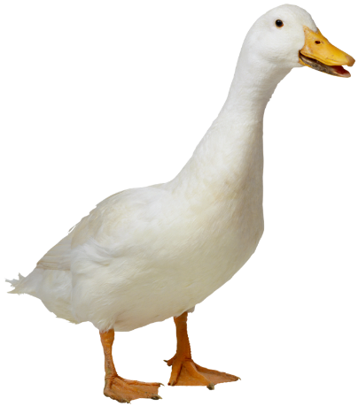
Rf values
Rf (retention factor) values are calculated by measuring how far the dot(s) have moved up the chromatography paper compared to how far the solvent has moved up the paper.
Rf = distance moved by the compound / distance moved by the solvent.

Slide 6
Stages in chromatography
Each type of chromatography has a mobile phase and a stationary phase.
In paper chromatography:
Mobile phase = the solvent
Stationary phase = the wet paper

Slide 7
Separation factors
When separating molecules, they will separate at different rates depending on factors such as size and polarity.
Larger molecules will move slower/less far.
Polar molecules will move further in a polar solvent compared to non-polar molecules.

Slide 8
Example of use
Chromatography is useful in analysing chemical reactions and what stage they are at.
Look at Fig. 17.3 on pg. 184 – this shows the formation of an ester from an alcohol and a carboxylic acid.
P= ester
Q= reaction mixture after 10 mins
R= the alcohol used in ester formation
S= the carboxylic acid in ester formation

Slide 9
Protein analysis
If a protein has been hydrolysed, the resultant amino acid components can be analysed using chromatography.
The hydrolysed mixture is dotted onto some chromatography paper alongside a selection of known amino acids.
The chromatography is then left to run and dried after 2-4 hours.
The paper is then sprayed with ninhydrin in order to visualise the results.

Slide 10
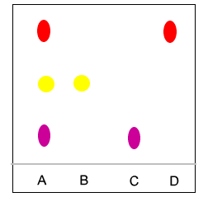
Protein analysis
A = Hydrolysed protein
B = Lysine
C = Valine
D = Proline
The hydrolysed protein contains all 3 amino acids.

Slide 11
2-way chromatography
Using this 1-solvent method can be unreliable because the amino acids do not separate out very well.
This can be improved by exposing the paper to one solvent for a time and then to a second solvent while also turning the paper (Fig.17.5 on pg. 185). This is called 2-way chromatography.
Ninhydrin can be used to visualise the results after the second solvent exposure.

Slide 12
2-way chromatography
In order to analyse the results, this process would also have to be repeated identically with the samples of known, purified amino acids.

Slide 13
GLC and HPLC
Paper chromatography is a very primitive method by today’s standards.
Gas Liquid Chromatography (GLC) and High-Performance Liquid Chromatography (HPLC) are much more common and accurate.
They both have a mobile and stationary phase (like before).
The separate compounds based on size/polarity (like before).

Slide 14
GLC
The mobile phase is an inert gas e.g. He or N₂
The stationary phase is a high boiling point liquid that is adsorbed onto an inert solid which is placed in a long, coiled column.
Chromatogram results are as follows:
Y-axis = component quantity
X-axis = retention time (time taken for the compound to reach the detector).

Slide 15
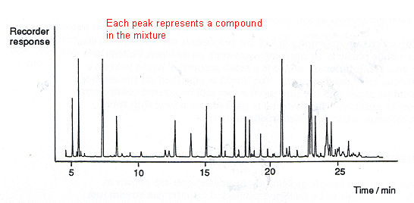
GLC (and HPLC) chromatogram

Slide 16
What do the results mean?
If a polar stationary phase (liquid in the column) is used then polar compounds would be expected to have a longer retention time compared to non-polar compounds.
This is because the polar compounds would be more strongly attracted to the stationary phase.
This means it would take longer for them to reach the detector.

Slide 17
Practical uses
Forensics!
You start a fire in someone’s house using petrol (no-one died, but the house is now a heap of ash….thank guys…)
A sample of petrol will be heated in a sealed container until it produces gases – these are collected by syringe and injected into the GLC.
A remnant of curtain found on the floor could also be heated, gases obtained and injected into the GLC. This could be repeated with a piece of your clothing.
If the peaks match….

