Slide 1
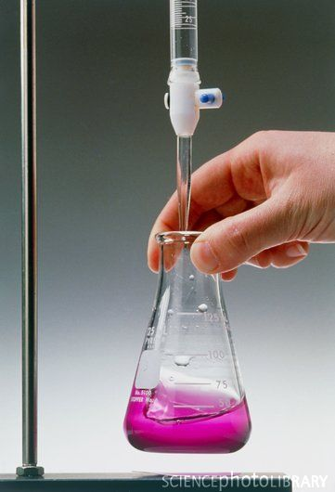
Chemistry in Society Volumetric analysis
Iain Cameron
ICameron@glasgowkelvin.ac.uk

Slide 2
Volumetric analysis
Allows the calculation of quantity or concentration of one reactant if we have all relevant information about the other reactant.
Titration is a type of volumetric analysis.
E.g. If we know the volume and concentration of an acid or alkali then we can work out the concentration of a solution with the opposite pH.

Slide 3
Steps for titration
Add a known concentration and volume of an acid/alkali to a conical flask using a pipette.
Add an indicator to the solution.
Fill a burette with a solution of the opposite pH to the solution in the conical flask.
Slowly empty the burette using the tap until the indicator changes colour.
Note the volume used from the burette and repeat until concordant results are achieved.

Slide 4
Redox titrations
These require you to have the following information:
A balanced redox equation
Known concentration + volume of reducing/oxidising agent
Known volume of opposite agent

