Slide 1
Calculating Energy Changes
Objectives:
Calculate energy needed and released when bonds are broken and made
Compare endothermic and exothermic reactions in terms of their bond energies

Slide 3
a) any three from:
• concentration of (salt) solution
• volume of (salt) solution
ignore amount of solution
• initial temperature (of the solution)
ignore room temperature
• surface area / form of metal
• moles of metal
allow mass / amount
ignore time
ignore size of tube
3

Slide 4
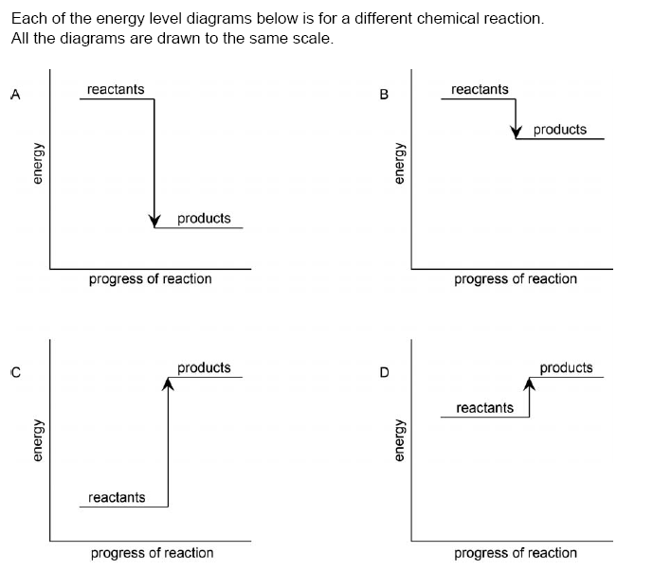
Answer the following questions
Which reaction do you think is most exothermic?
Which reaction do you think is most endothermic?
Which two reactions do you think cause the temperature of the surroundings to increase?
Which one will cause the smallest temperature decrease?
Challenge: explain your reasoning

Slide 5
Which reaction do you think is most exothermic? A

Slide 6
Which reaction do you think is most endothermic? C

Slide 7
Which two reactions do you think cause the temperature of the surroundings to increase? A and B

Slide 8
Which one will cause the smallest temperature decreases? D

Slide 9
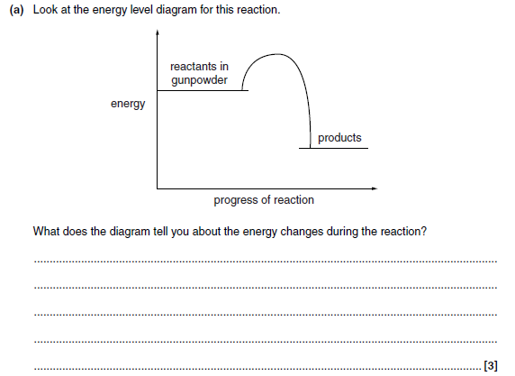
Answer this in your book

Slide 10
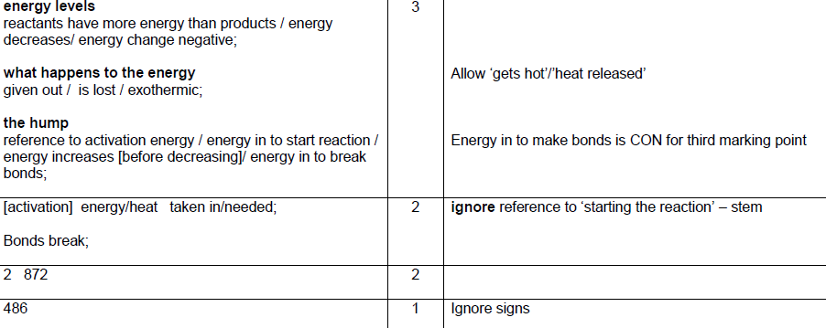

Slide 11
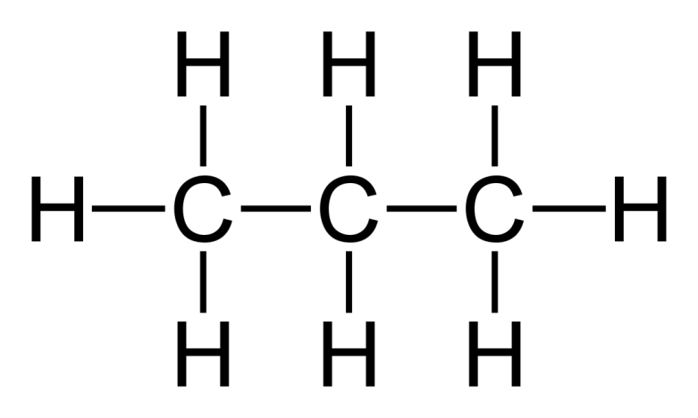
Work out how much energy is needed to break the bonds in the following molecules
2 x C – C bonds
8 x C – H bonds
(2 x 348) + (8 x 435) = . .. . .. . kJ/mol
Bond | Bond enthalpy (kJ/mol) | Bond | Bond enthalpy (kJ/mol)
C—H | 435 | Cl—Cl | 243
C—C | 348 | C—Cl | 346
H—H | 436 | H—Cl | 452
H—O | 463 | O=O | 498
H – Br | 366 | C=O | 804

Slide 12
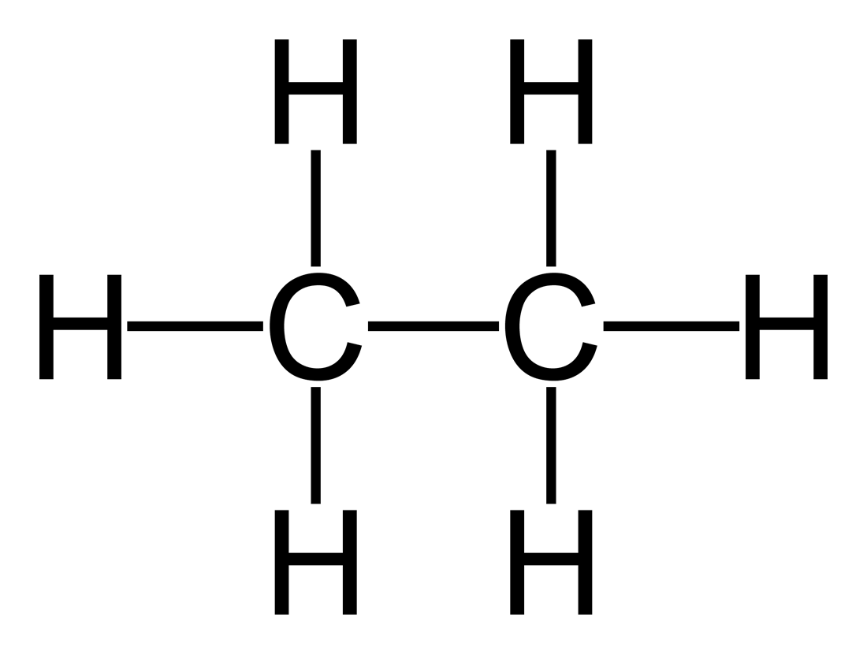
Work out how much energy is needed to break the bonds in the following
c) Ethane
a) Hydrogen bromide
b) Water
d) 2 molecules of Hydrogen, H₂
Bond | Bond enthalpy (kJ/mol) | Bond | Bond enthalpy (kJ/mol)
C—H | 435 | Cl—Cl | 243
C—C | 348 | C—Cl | 346
H—H | 436 | H—Cl | 452
H—O | 463 | O=O | 498
H – Br | 366 | C=O | 804

Slide 13
Overall Energy Change = Energy needed - Energy given out
to break bonds when bonds form
If the energy needed to break the bonds is higher, then the overall energy change is positive. More energy is taken in than released therefore the reaction is Endothermic
If the energy given out during bond formation is higher, then the overall energy change is negative. More energy is released than taken in therefore the reaction is Exothermic

Slide 14
O
H
H
H
H
O
O
O
H
H
H
H
2H₂ + O₂ 2H₂O

Slide 15
O
H
H
H
H
O
O
O
H
H
H
H
2H₂ + O₂ 2H₂O
Energy needed to break bonds
(2 x H – H) + (1 x O = O)
(2 x 436) + (1 x 498) = 1370

Slide 16
O
H
H
H
H
O
O
O
H
H
H
H
2H₂ + O₂ 2H₂O
Energy needed to break bonds
(2 x H – H) + (1 x O = O)
(2 x 436) + (1 x 498) = 1370
Energy released when bonds are made
(4 x O – H)
(4 x 464) = 1856

Slide 17
O
H
H
H
H
O
O
O
H
H
H
H
2H₂ + O₂ 2H₂O
Energy needed to break bonds
(2 x H – H) + (1 x O = O)
(2 x 436) + (1 x 498) = 1370 kJ/mol
Energy released
(4 x O – H)
(4 x 464) = 1856 kJ/mol
Overall Energy Change = Energy needed - Energy given out
to break bonds when bonds form
= 1370 – 1856 = - 486 kJ/mol -ve therefore exothermic

Slide 18
O
H
H
H
H
O
O
O
H
H
H
H
2H₂ + O₂ 2H₂O
Energy needed to break bonds
(2 x H – H) + (1 x O = O)
(2 x 436) + (1 x 498) = 1370 kJ/mol
Energy released
(4 x O – H)
(4 x 464) = 1856 kJ/mol
Overall Energy Change = Energy needed - Energy given out
to break bonds when bonds form
= 1370 – 1856 = - 486 kJ/mol -ve therefore exothermic

Slide 19
Hydrogen and chlorine reacting to form hydrogen chloride
H₂ + Cl₂ → 2HCl
H−H + Cl−Cl → 2 × (H−Cl)
2) Hydrogen bromide decomposing to form bromine and hydrogen
2HBr → H₂ + Br₂
2 × (H−Br) → H−H + Br−Br
3) Methane reacting with oxygen to form carbon dioxide and water
CH₄ + 2O₂ → CO₂ + 2H₂O
Classify each reaction as endothermic or exothermic
Bond | Bond enthalpy (kJ/mol) | Bond | Bond enthalpy (kJ/mol)
C—H | 435 | Cl—Cl | 243
C—C | 348 | C = O | 804
H—H | 436 | H—Cl | 432
H—O | 463 | O=O | 498
H – Br | 366 | Br - Br | 193

Slide 20
Hydrogen and chlorine reacting to form hydrogen chloride
H₂ + Cl₂ → 2HCl
H−H + Cl−Cl → 2 × (H−Cl)
Energy in = 436 + 243 = 679 kJ/mol 1 mark
Energy out = 2 × 432 = 864 kJ/mol 1 mark
Energy change = in – out = 679 – 864 = –185 1 mark kJ/mol
Exothermic 1 mark

Slide 21
2) Hydrogen bromide decomposing to form bromine and hydrogen
2HBr → H₂ + Br₂
2 × (H−Br) → H−H + Br−Br
Energy in = 2 × 366 = 732 kJ/mol 1 mark
Energy out = 436 + 193 = 629 kJ/mol 1 mark
Energy change = in – out = 732 – 629 = +103 kJ/mol 1 mark
Endothermic 1 mark

Slide 22
3) Methane reacting with oxygen to form carbon dioxide and water
CH₄ + 2O₂ → CO₂ + 2H₂O
Energy in = (4 × 435) + (2 x 498) = 2736kJ/mol
1 mark
Energy out = (2 x 804) + (4 x 463) = 3460kJ/mol
1 mark
Energy change = in – out = 2736– 3460= - 724 kJ/mol 1 mark
Exothermic 1 mark

Slide 23
Hydrogen and chlorine reacting to form hydrogen chloride
H₂ + Cl₂ → 2HCl
H−H + Cl−Cl → 2 × (H−Cl)
Energy in = 436 + 243 = 679 kJ/mol
Energy out = 2 × 432 = 864 kJ/mol
Energy change = in – out = 679 – 864 = –185 kJ/mol
Exothermic or endothermic?
Question 1: support sheet

Slide 24
Silver
Gold

Slide 25
Answers to Worksheet 5.4.2
−200 kJ/mol, exothermic;
−200 kJ/mol, exothermic

Slide 26
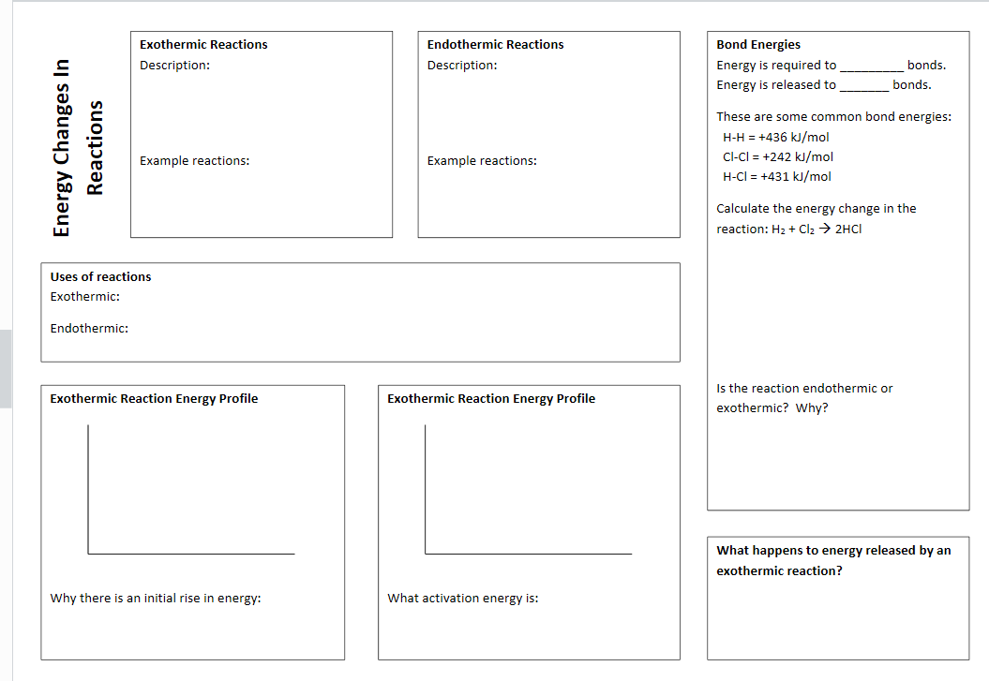

Slide 29
Getting started and going further answers
1 oC (1)
2 a) thermometer (1)
3 Sports injury packs and self-heating cans
4 b endothermic (1)
5 50 g of water sample (1)
6 They put hardboard mats around their
experiment to ensure that all the heat
generated from the fuel is used to heat the
water and not lost to the atmosphere. (1)
7 oC 20 28 34 36 37 exothermic reaction
cm3 0 15 20 24 26 rate of reaction by gas
volume
oC 21 18 16 15 14 endothermic reaction (2)
8 J (1)
9 b) it is lower than the energy of the products
10 The activation energy is marked between the
energy level of the reactants and the hightest
energy level the reaction gets to before
generating products
11 A beaker of water is put over the fuel and the
temperature of the water is taken before it
starts to burn and after it has burnt. Each
beaker contains the same amount of water at
the same distance from the fuel. The fuel that
burned to give the most temperature
difference was the fuel producing the most
energy.
12 Same equipment used; same amount of water
used each time, same amount of fuel used
each time. (2)

Slide 32
13 It needs a source of energy to get over the
activation energy barrier (1)
14 It is important to minimise heat loss to ensure
that the most accurate measurement of the
change in temperature (1)
15 When citric acid is added to sodium hydrogen
carbonate solution the temperature decreases
– it is an endothermic reaction. This means
that the energy released when new bonds are
made to make the products is less than the energy taken in when breaking the bonds
16 When a reaction begins the different reactants
collide with each other and those that have
enough energy to get over the activation
energy will react to form products. (2)
17 a 1,596
b 930
c 2,852
18 A reaction can be exothermic if the energy
released when bonds are formed in the
products is more than the energy taken in
during the endothermic process of breaking
the bonds in the reactants.
19 CH4 1,656
2O2 996
CO2 1596
2 H2O 1860
CH4 + 2O2 = 2652
CO2 + 2H20 = 3456
Energy change = 2652-3456
= -804
More challenging and more demanding answers
20: Level 3: Correctly calculates energy change
for methane and propane (one ecf allowed)
and concludes that concludes propane gives
out more energy (3-4)
Level 2: Correctly calculates energy change
for methane or propane (one ecf allowed). (2)
Level 1: Correctly calculates reactant or
product bond energy for methane or propane
reactions. (1)
Nothing written worthy of credit. (0)
Indicative content
Calculating Energy Change for Methane
• Reactant bond energy = (4 x 414) +(2 x
498) = 2652
• Product bond energy = (2 x 806) +(4 x
465) = 3472
• Overall energy change = 2652 ‒ 3472 = ‒
820 kJ/mol. Negative sign not essential.
Calculating Energy Change for Propane
• C3H8 + 5 O2 → 3 CO2 + 4 H2O
• Reactant bond energy = (8 x 414) +(5 x
498) + (2 x 346)= 6494
• Product bond energy = (6 x 806) +(8 x
465) = 8556
• Overall energy change = 6494 ‒ 8556 = ‒
2062 kJ/mol. Negative sign not essential.
• Propane gives out (1242 KJ/mol) more
energy than methane.
309

Slide 33
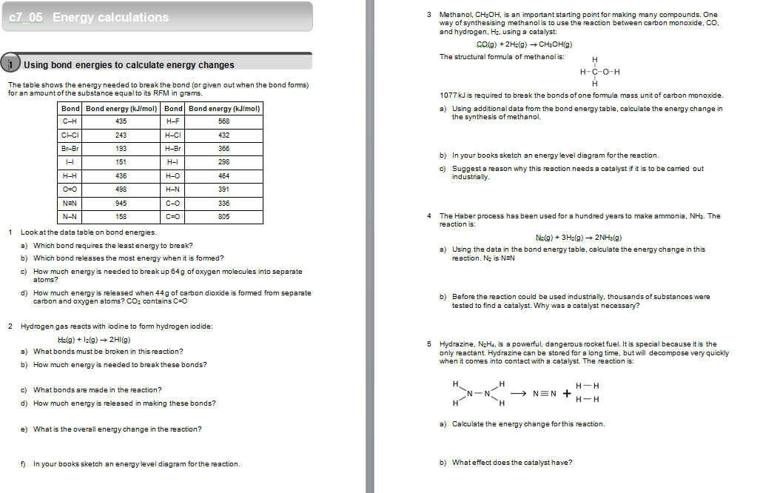
Energy Calculations (H only)
Activity 1
Complete Q 1- 3

Slide 34
Energy Calculations (H only)
Activity 1
Q1 a) I–I b) N≡N c) ( 2 x 498) = 996 kJ/mol
d) = ( 2 x 805)= 1610 kJ/mol
Q2 a) H–H and I–I b) (436 + 151) = 587 kJ c) H–I
d) ( 2 x 298)= 596 kJ e) 587 – 596 = −9 kJ/mol
f) Energy level diagram showing E_{A} peak; products
just lower than the reactants.
Q3 a) ((1077 + (2x 436)) – ((3 x 435) + 336 + 464)) = −156 kJ/mol
b) Energy level diagram with very high E_{A} peak; products just lower than the reactants.
c) The reaction has a very high activation energy and would be very slow unless a catalyst is used to lower it.

Slide 35
Energy Calculations (H only)
Activity 1
Complete Q 4- 5

Slide 36
Energy Calculations (H only)
Activity 3
Q4 a) ((1x945) + (3x 436)) – (6 x391) = −93 kJ
b) The reaction is very slow without a catalyst because it has a very high activation energy.
Q5 a) ((4x 391) + (1x 158)) – ((1x945) + (2x436) = −95 kJ/mol
b) The catalyst reduces the activation energy to almost zero so that the reaction can take place fast.

Slide 37
Energy Calculations (H only)
How can we tell by looking at the energy from making & breaking bonds that the formation of HCl from H₂ & Cl₂ is exothermic?
Hydrogen reacts with bromine to form hydrogen bromide:
H_{2(g)} + Br_{2(g)} → 2HBr(g)
Use the bond energies in the table on your worksheet for the following:
a . What is the total amount of energy needed to break up the reactants in the equation?
b. What is the total energy given out by bonds formed in the reaction?
c. What is the energy change for the reaction? Is it
exothermic or endothermic? Explain your answer

Slide 38
Energy Calculations (H only)
Q1 The energy given out making bonds is greater than the
energy put in to break bonds.
Q2 a) ( 436 + 193) = 629 kJ/mol
b) (2 x 366) = 732 kJ/mol
c) 629 – 732 = -103 kJ/mol
Exothermic; more energy given out than taken in.

Slide 39
Energy Calculations (H only)
3. Use the data in the table on your worksheet to calculate the energy given out when methane is burned.
CH_{4(g)} + 2O_{2(g)} → CO_{2(g)} + 2H₂O(g)
4 x C-H = 4 x 435 = 1740 + 2 x O=O = 2 x 498 = 996 = 2736
2 x C=O = 2x 805 = 1610 + 4 x O-H = 4 x 464 = 1856 = 3466
2736 – 3466 = -730 (kJ/mol)

