Slide 1

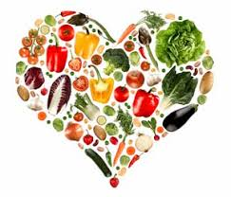
Nutrition, Health and Wellbeing
Unit Code:- F40G 11

Slide 2

Aims and Objectives
LO1- Identify the key elements of nutrition in relation to a healthy, balanced diet.

Slide 3

Assessment
Learning Outcome 1
Part 1- Closed book in class assessment
Part 2- Open Book in class assessment (menus)
Learning Outcome 2
Part 1 and 2 both open book assessment one in the form of a portfolio
Learning Outcome 3
Part 1- Open Book
Part 2-Open Book and Practical

Slide 4
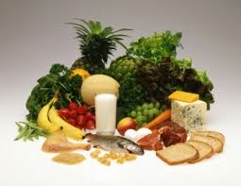
Nutrition
Definition:
The process of providing or obtaining the food necessary for health and growth.
(Oxford Dictionary, 2018)

Slide 5
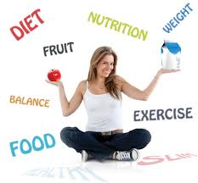
Nutrition
For every physical/daily activity, the body requires energy and the amount depends on the duration and type of activity.

Slide 6
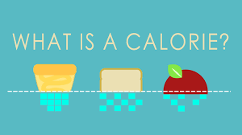
Nutrition- Calories
Energy is measured in Calories and is obtained from the body stores or the food we eat.
A calorie (cal) is the amount of energy required to raise the temperature of 1g of water 1°C from 14° to 15°C.
A kilocalorie (kcal) is the amount of energy required to raise the temperature of 1000g (1KG) of water 1°C.

Slide 7
The Harris–Benedict equations revised by Mifflin and St Jeor in 1990:^{[4]}
Step 1 – Calculating the Harris–Benedict BMR
Men | BMR = (10 × weight in kg) + (6.25 × height in cm) - (5 × age in years) + 5
Women | BMR = (10 × weight in kg) + (6.25 × height in cm) - (5 × age in years) - 161
Step 2 – Determine Recommended Intake
Little to no exercise | Daily kilocalories needed = BMR x 1.2
Light exercise (1–3 days per week) | Daily kilocalories needed = BMR x 1.375
Moderate exercise (3–5 days per week) | Daily kilocalories needed = BMR x 1.55
Heavy exercise (6–7 days per week) | Daily kilocalories needed = BMR x 1.725
Very heavy exercise (twice per day, extra heavy workouts) | Daily kilocalories needed = BMR x 1.9
Step 3 – TASK – Calculate you own!

Slide 8
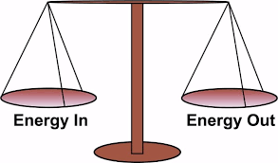
Nutrition Balance
Carefully planned nutrition must provide an energy balance and a nutrient balance.
What happens if we eat more than we burn?
What happens if we eat the amount of calories we burn?
Generally, How many calories should a male have a day?
Generally, How many calories should a female have a day?

Slide 9
Nutrition Balance
Do you know the 7 nutrients?
The nutrients are:
Proteins - essential to growth and repair of muscle and other body tissues
Fats - one source of energy and important in relation to fat soluble vitamins
Carbohydrates - our main source of energy
Minerals - those inorganic elements occurring in the body and which are critical to its normal functions

Slide 10
Nutrition Balance
Vitamins - water and fat soluble vitamins play important roles in many chemical processes in the body
Water - essential to normal body function - as a vehicle for carrying other nutrients and because 60% of the human body is water
Fibre (Roughage) - the fibrous indigestible portion of our diet essential to health of the digestive system.

Slide 11
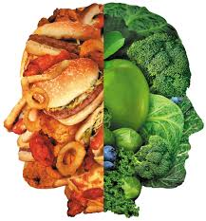
Healthy Eating
Eat every 2-3hrs
Eat more fruit and veg (fruit juice, soups and smoothies count)
Vary your diet
Eat more boiled or jacket potatoes, pasta, rice dishes
Eat more lean meat, breast of chicken or turkey and fish
Make sure you drink plenty of fluids (tea/coffee/fizzy juice don’t count)

Slide 12
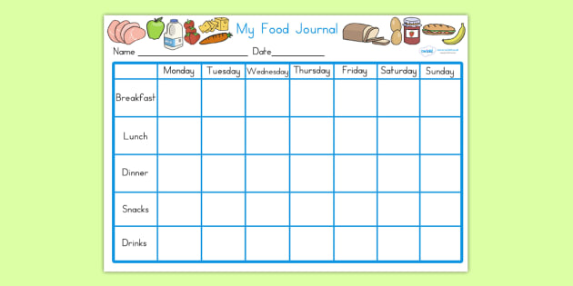
Food Diary
1 week
Everything you eat and drink (Everything)
Label and calculate your calories each day
Take note of what exercise you have done for duration and calories burned if possible.

